Slide 1
Redefining RBC Removal
Notes:
Hello Everyone, and thank you for taking the time to learn about one of the latest additions to the LevitasBio platform.
*I’d next like to talk about one of the latest additions to our platform; the LeviSelect RBC Depletion Kit. For many individuals, RBC removal is a necessary step to avoid any negative impacts these life-giving cells may have on downstream assays such as culturing, functional assays, flow cytometry, and especially single cell sequencing. Over the next 20 minutes or so, I’d like to provide some additional background information about the impact of contaminating RBCs on downstream assays, and then discuss some of the approaches and associated drawbacks of current methods commonly utilized for RBC removal. The remainder of the talk will focus on how our technology provides an alternative approach for superior RBC removal.

Slide 2
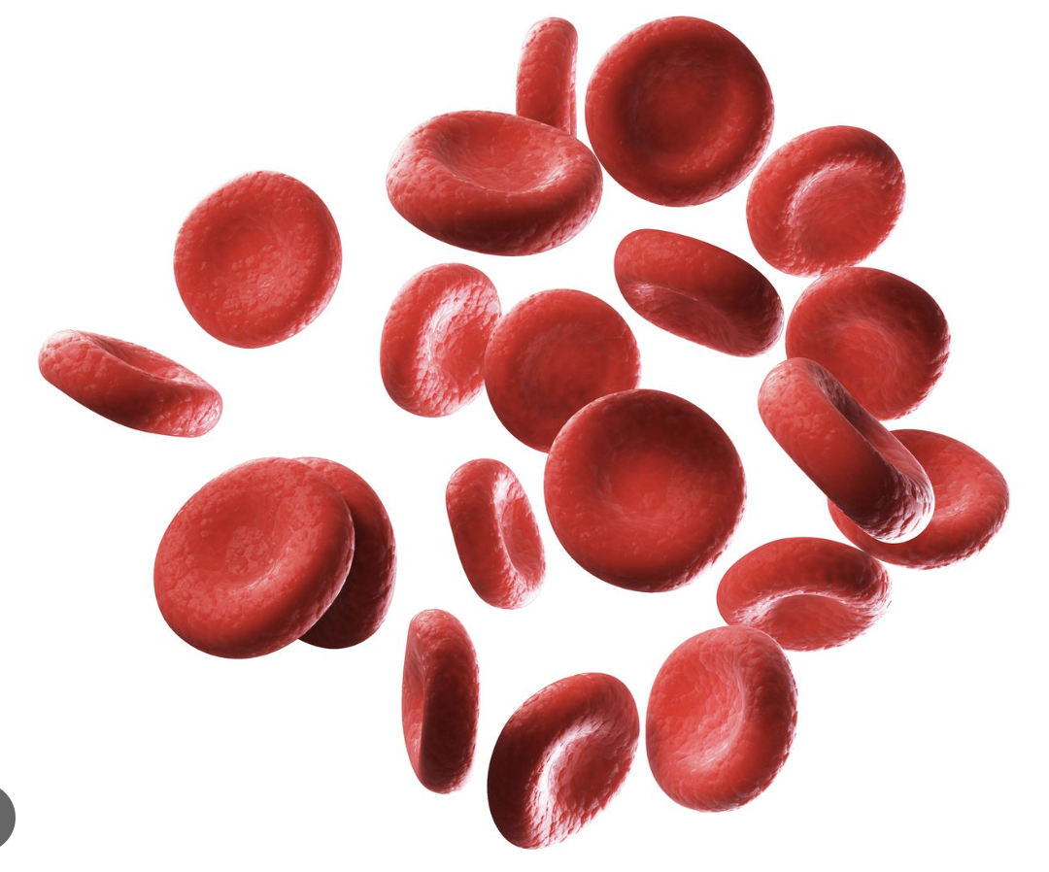
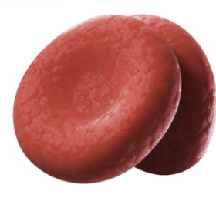
The Need for Better Methods of RBC Removal
RBC’s can be a source of significant sample contamination
Removal steps are often harsh and incomplete
Current methods can result in variability and cell loss
They can impede accurate flow gating and analysis
Their presence reduces sequencing efficiency and depth
Result in significant amounts of wasted resources
Notes:
We know that for certain sample types, RBCs are a source of significant sample contamination, and the impact of their presence can have considerable experimental consequences. To address this, several methods have been developed over the years to remove these contaminants, and many of these methods are harsh, variable, lead to significant cells loss, and are often incomplete. But why is it so important for the research community to remove these cells? I’ll briefly highlight two commonly used downstream assays as an example.

Slide 3
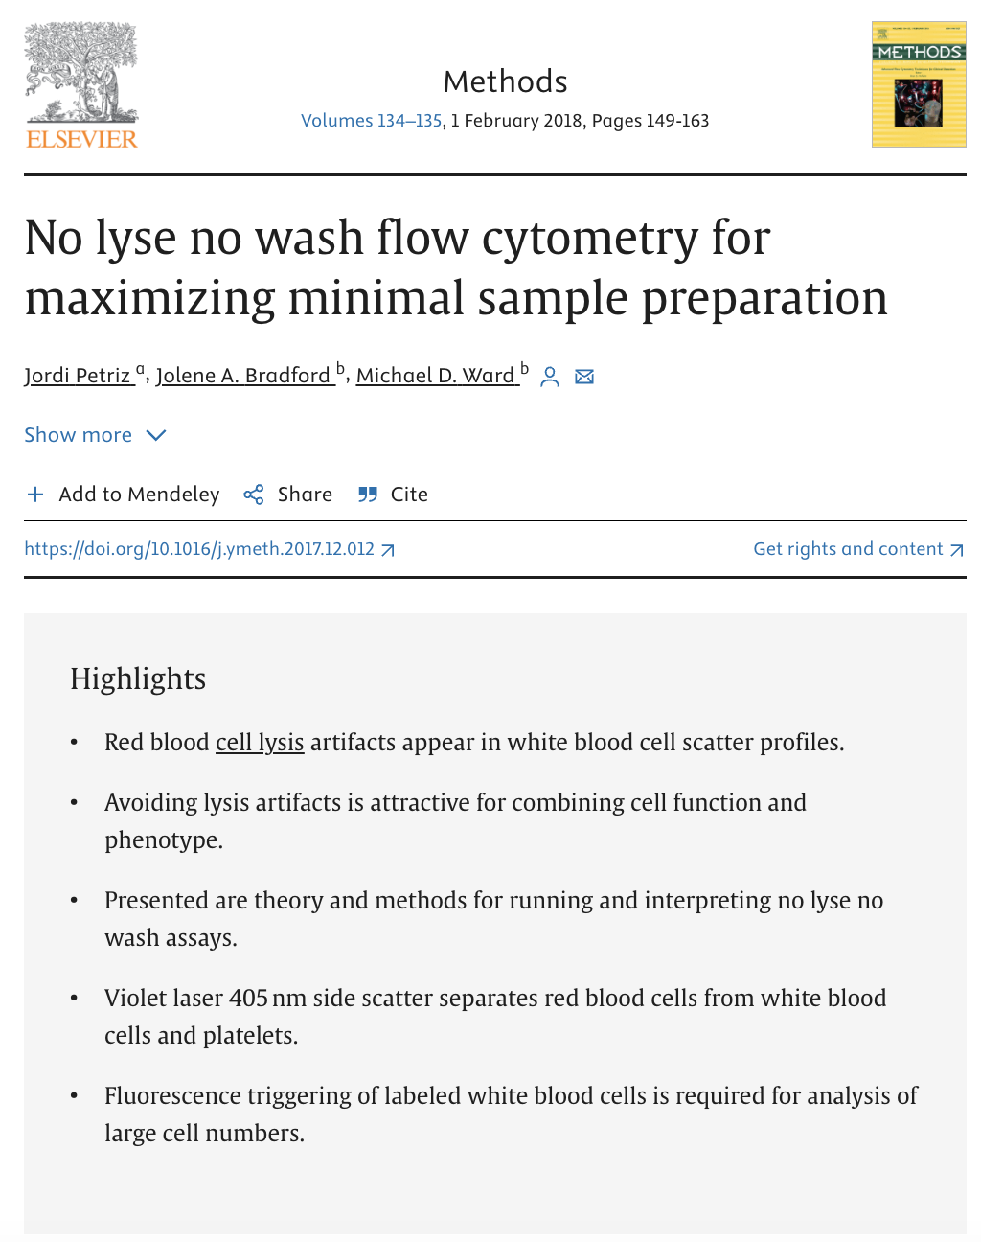
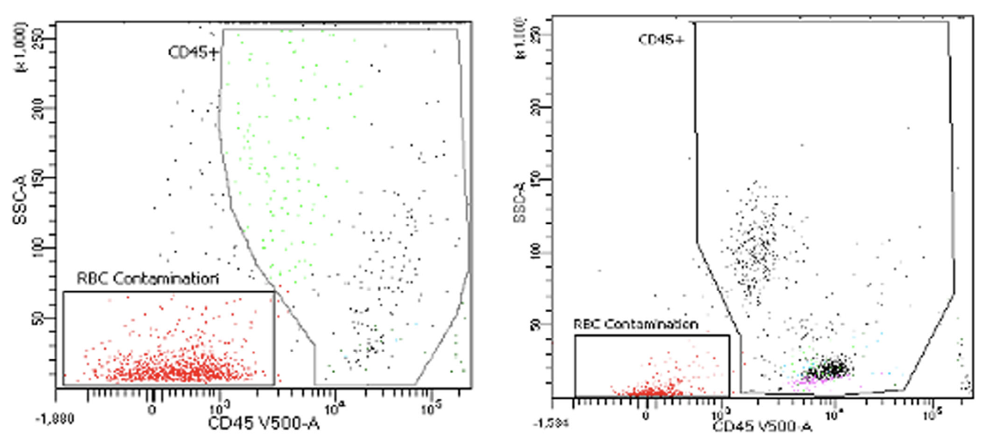
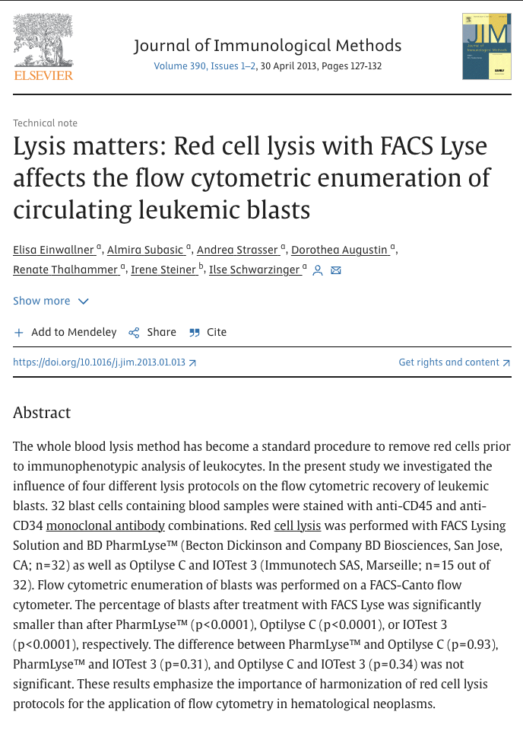
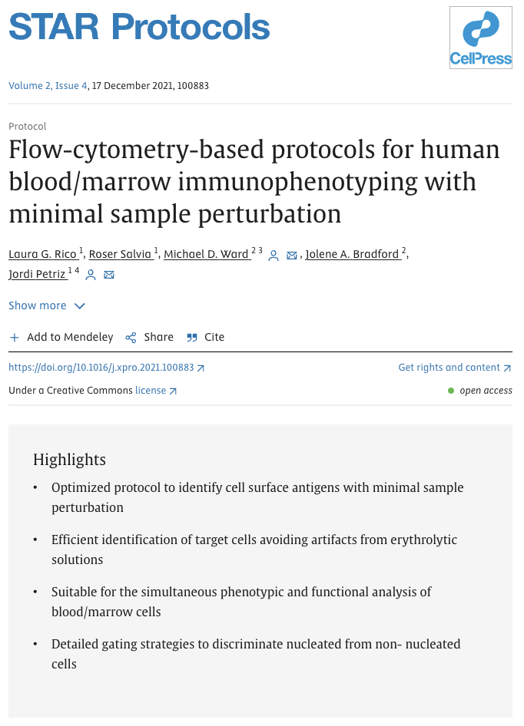
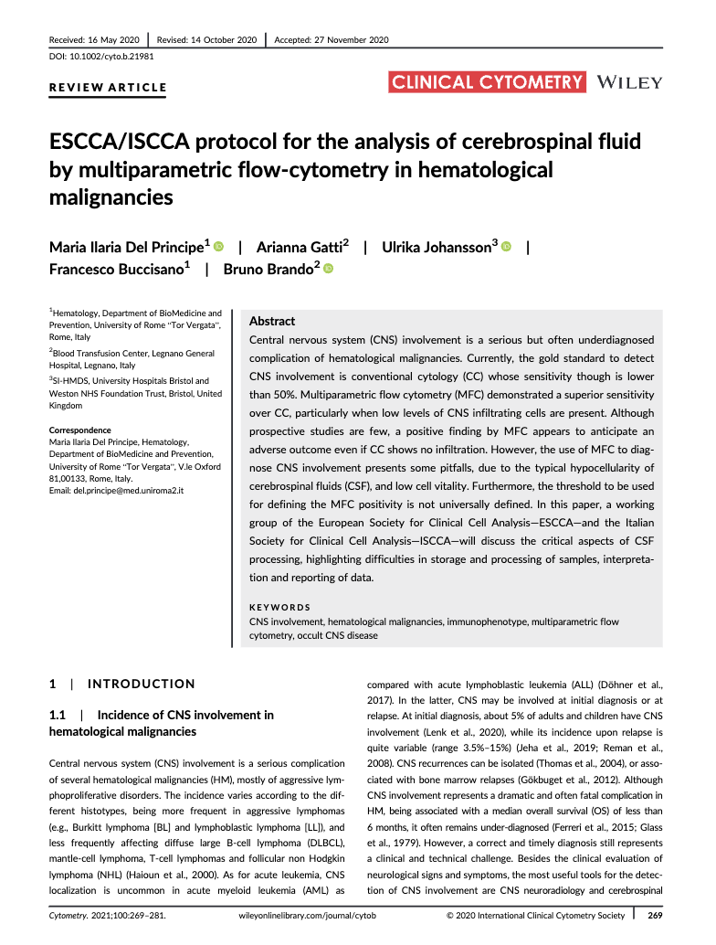
Impeding the Flow of Discovery
RBCs need to be removed or lysed for proper gating
Lysis can result in altered phenotypes and distribution
This presents a major challenge for reproducible discovery

Slide 4
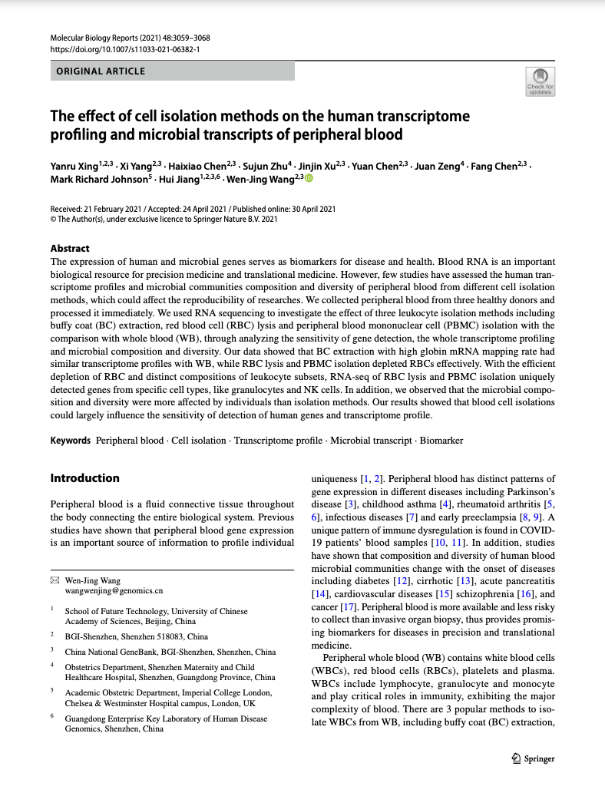
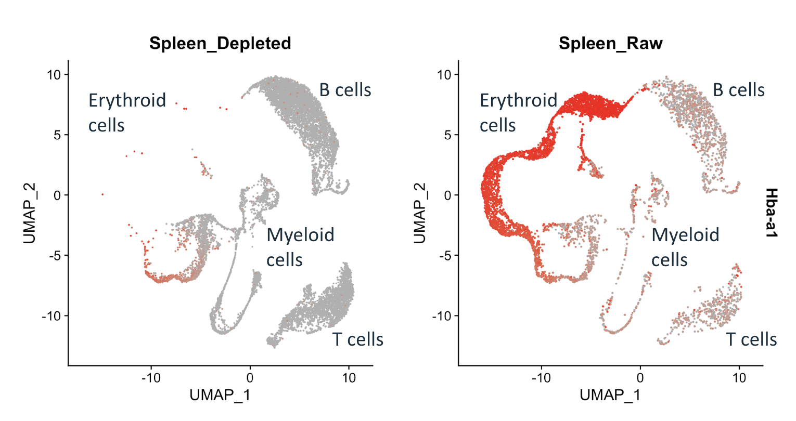
Wasted Money, Samples, and Time on Sequencing
Quality of Data
Variable cell quality and input
Impedes accurate cell counts
Difficult to filter background noise
Reduced depth of reads
Impacts ability to resolve population representation
Resource Expenditure
Costly sequencing of unwanted cell types
More hands-on time, variability, and effort required for data analysis
Sample loss and unusable data sets

Slide 5
Wasted Money: An Internal Case Study
% of Total Cells: | RBC depleted |  | RBC lysis
 | Spleen 1 | Spleen 2 | Spleen 1 | Spleen 2
Cells with < 200 features: | 0.5% | 0.7% | 9.2% | 4.7%
Cells with >10% mitochondrial genes: | 5.0% | 6.6% | 18.1% | 13.7%
Cells associated with both: | 5.1% | 6.6% | 25.9% | 16.9%
Resource Expenditure
Cost of reagents and sequencing
Technician time and effort
Precious and often irreplacable samples

Slide 6
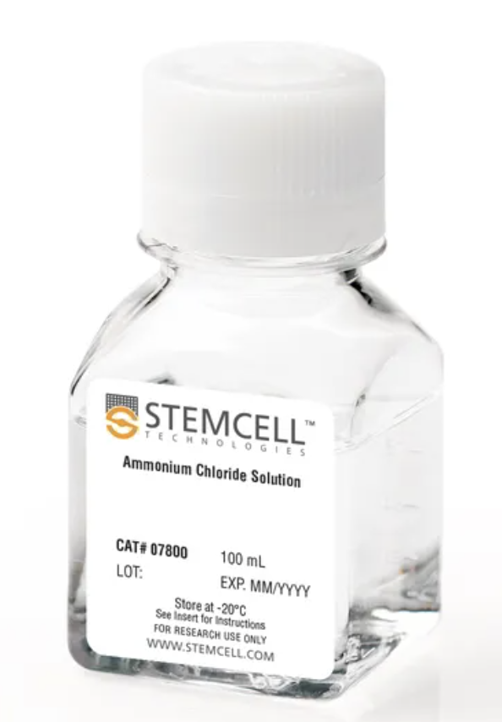
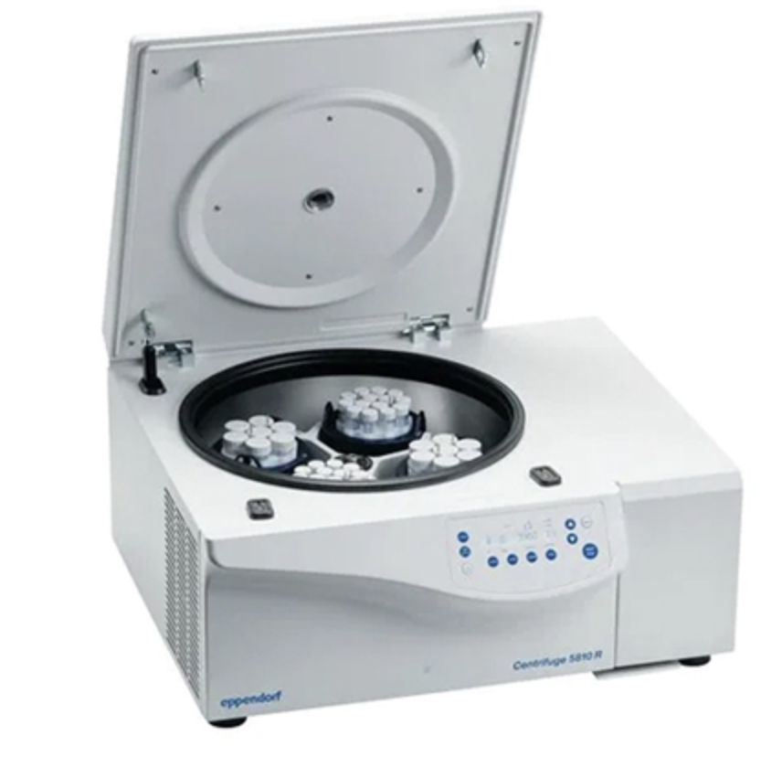
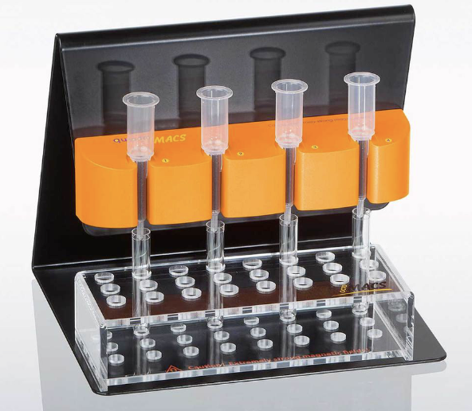
Challenging Landscape: Common RBC Removal Methods
RBC Lysis
Subjects entire sample to osmotic pressure
Manual, time-sensitive process
Incomplete and can lyse sensitive cells
Centrifugation
Time consuming and manual process
Requires certain degree of technical skill
Risk of significant variability and cell-loss
Beads/Columns
Manual and costly process
Physical limitations can lead to clogging
Similar to centrifugation, method is not suitable for low cell numbers

Slide 7
RBC Depletion Kit

Slide 8
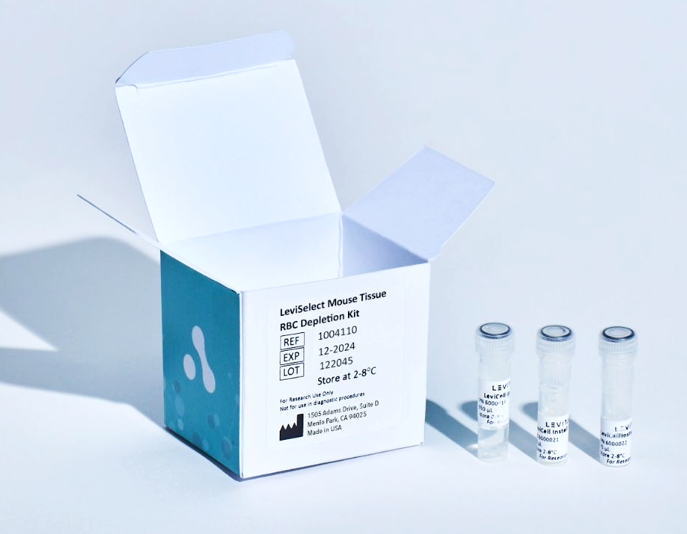
Remove RBCs and Obtain Necessary Sample Quality
Semi-automated process efficiently depletes developing and mature RBCs from tissue
Avoid harsh RBC removal processes such as lysis
Reduce variability and hands-on time with minimal technical skill requirements
Improve accuracy of sample quantification
Increase data quality and resolution
Maximize resources spent on downstream applications
LeviSelect RBC Depletion Kits
Part Number: 1004110 Mouse
Part Number: 1004112 Human

Slide 9
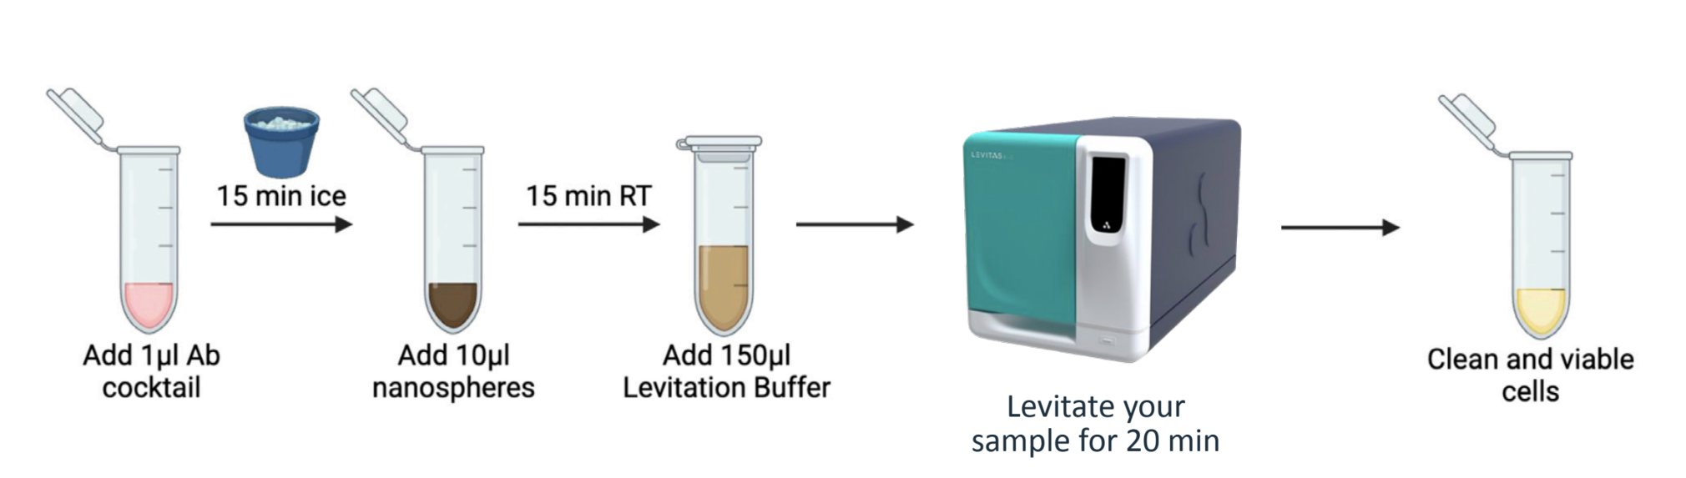
Gentle and Lysis-Free RBC Depletion from Tissue
The LeviSelectTM Human and Mouse Tissue RBC Depletion Kits utilize a simple protocol that efficiently and effectively removes red blood cells from a variety of tissue types. The gentle process simultaneously removes dead/dying cells and debris, all without the use of lysis-based approaches.
Workflow Overview

Slide 10
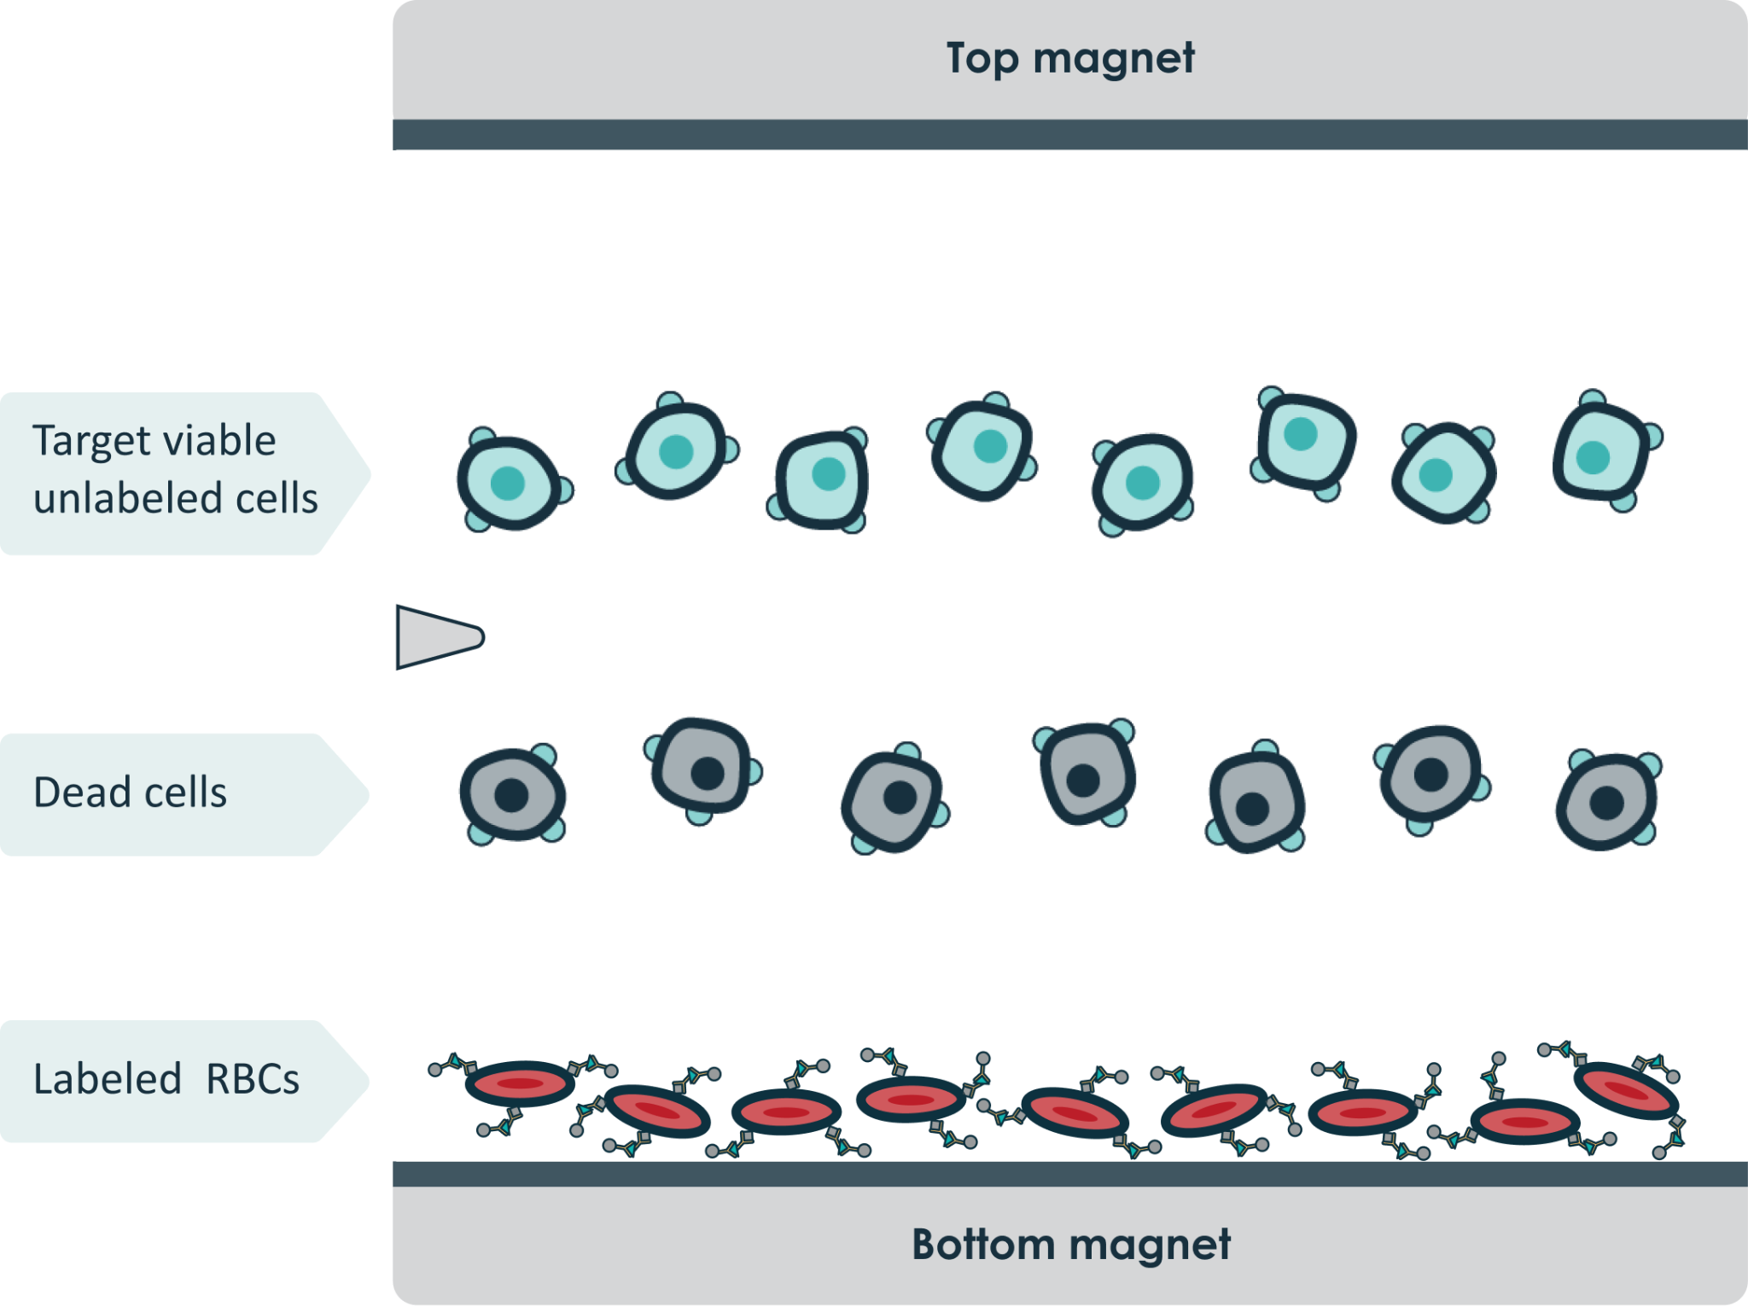
Eliminate Unwanted RBCs and Other Contaminants
Enrich for viable cells of interest
Remove debris and dead/dying cells
Effectively deplete RBCs from tissue

Slide 11
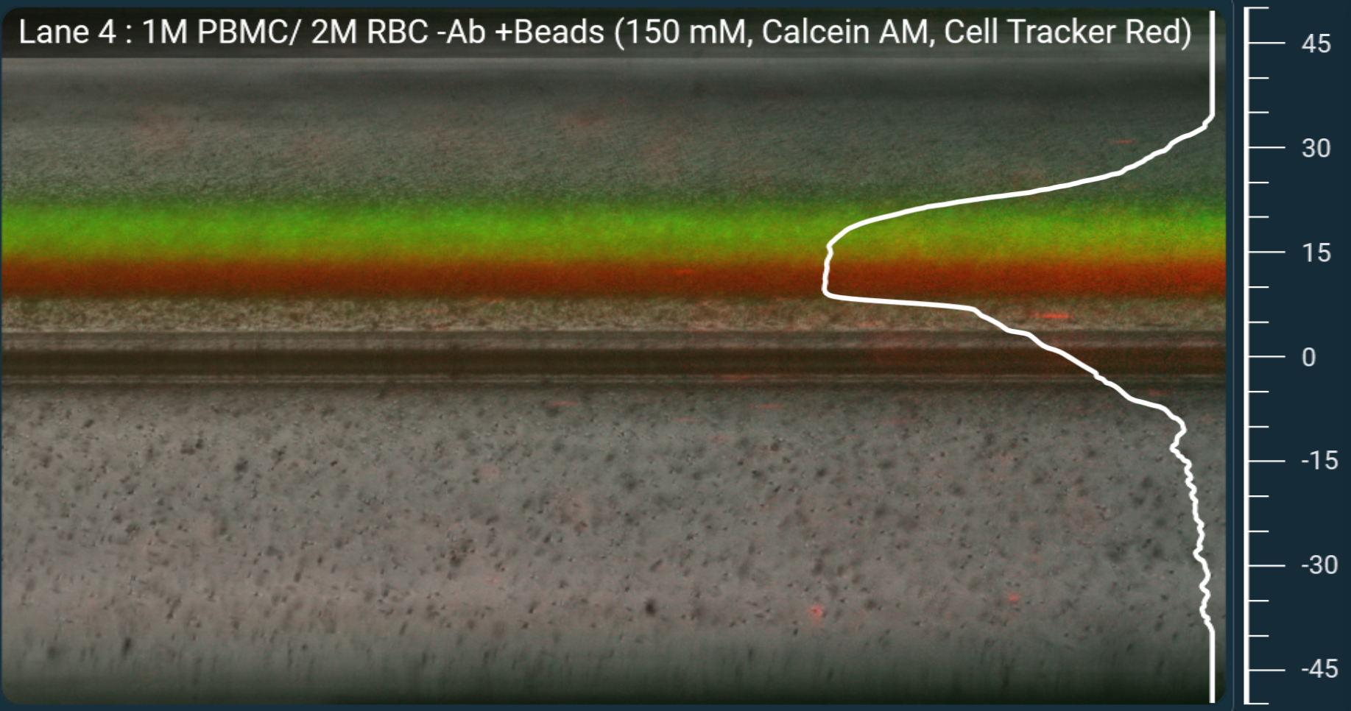
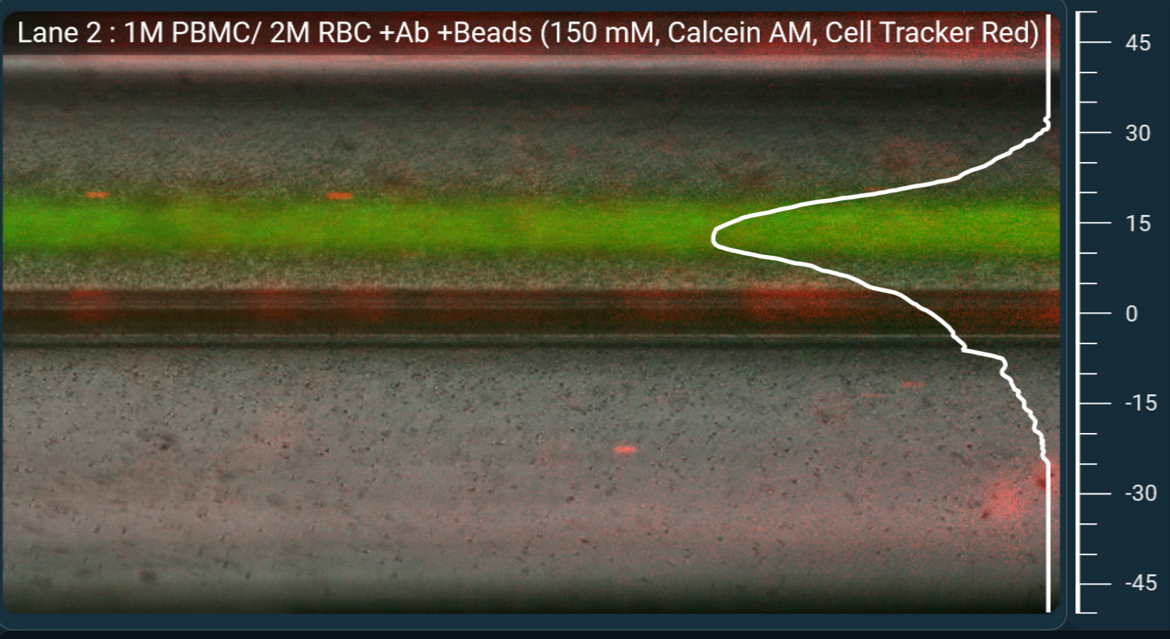
Visualizing RBC Depletion with LeviMetrics
No RBC Depletion
With RBC Depletion
PBMCs
Advanced QC metrics for processed samples
Enhanced analytical software now available
Gain additional insights for data interpretation
RBCs
PBMCs

Slide 12
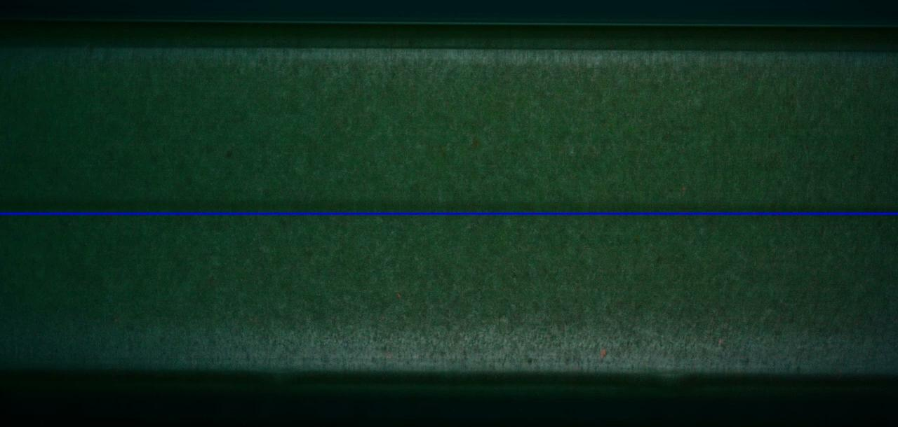
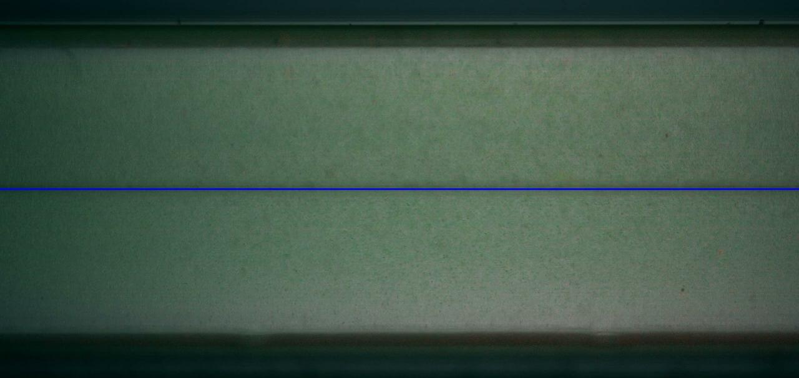
The Future of Sample Analysis
Nucleated Cells
RBCs
No RBC Depletion
Real-time visualization of RBC depletion
Simultaneous dead cell and debris removal
Evaluate depletion with a time-lapse video
With RBC Depletion

Slide 13
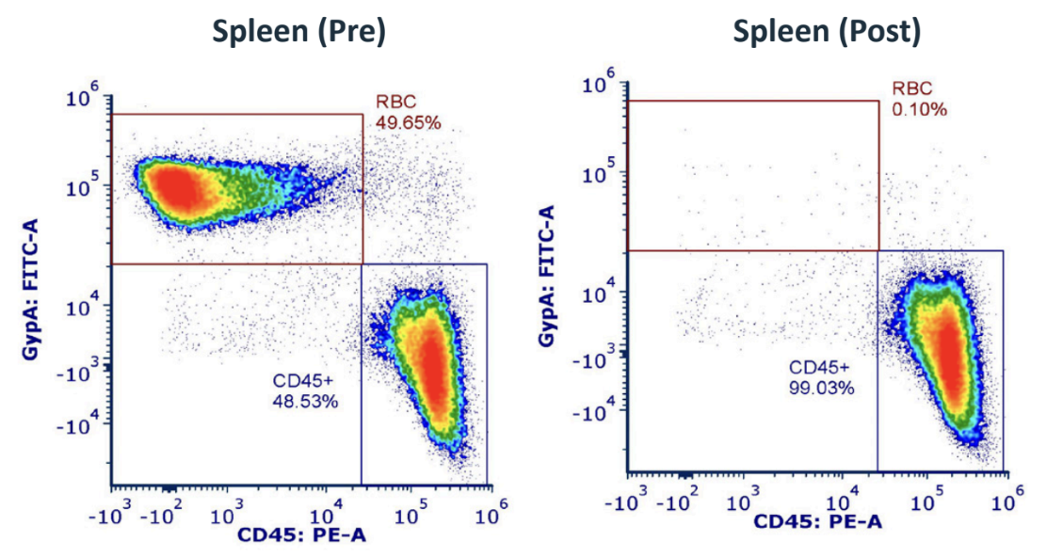
Exceptional RBC Depletion from Spleen
No RBC Depletion
With RBC Depletion
Process up to 5 million RBCs
Near 100% depletion rates
Suitable for a variety of tissues
Notes:
Getting human and mouse data from Laura

Slide 14
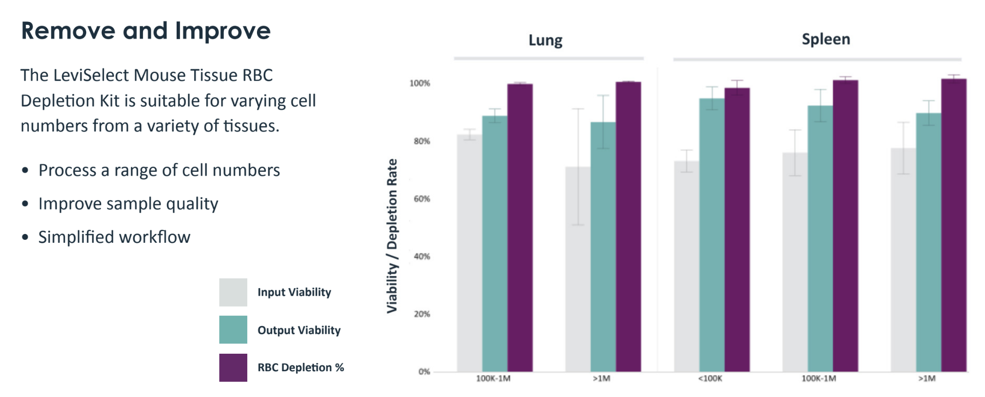
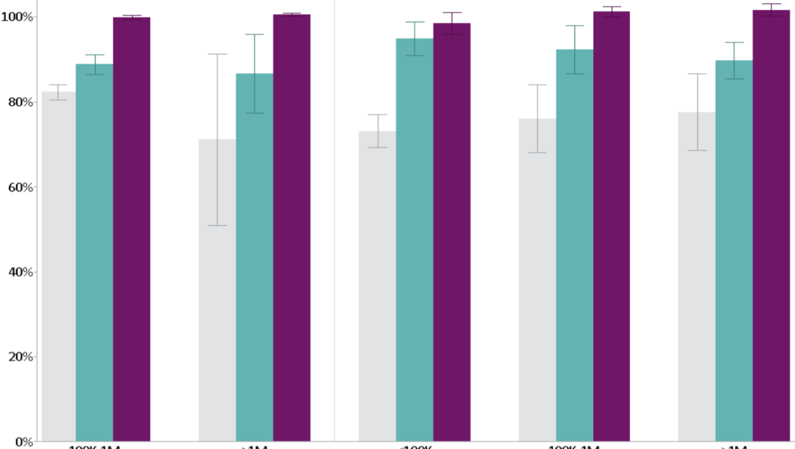
Simultaneous Sample Improvement Across Input Quantities
Exceptional RBC removal from varying sample quantities
Simultaneous removal of debris and dead/dying cells
Improve viability and overall sample quality
Viability/ RBC Depletion
100K-1M
> 1M
< 100K
100K-1M
> 1M
Cell #
Cell #

Slide 15
Reliable Tissue Agnostic RBC Depletion
Mouse Tissue | Depletion Rate % (mean ± SD) | Viability before | Viability after (mean ± SD)
Pancreas | 97.7 ± 0.0 | 39.1% | 70.2% ± 1.8
Brain | 98.1 ± 0.2 | 65.3% | 89.0% ± 10.5
Liver | 99.4 ± 0.1 | 69.0% | 89.0% ± 10.6
Spleen | 99.8 ± 0.0 | 69.1% | 94.8% ± 3.2
Lung | 99.0 ± 0.1 | 80.7% | 90.6% ± 1.2
Confidently remove RBCs from a variety of tissue types
Rescue low-quality or limited-quantity samples
Maximize sample and assay potential

Slide 16
Add description: pull from TN/Flyers
Advantage of Depletion Over Lysis

Slide 17


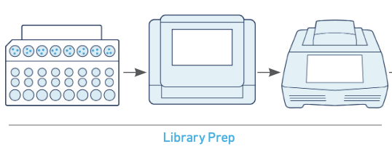
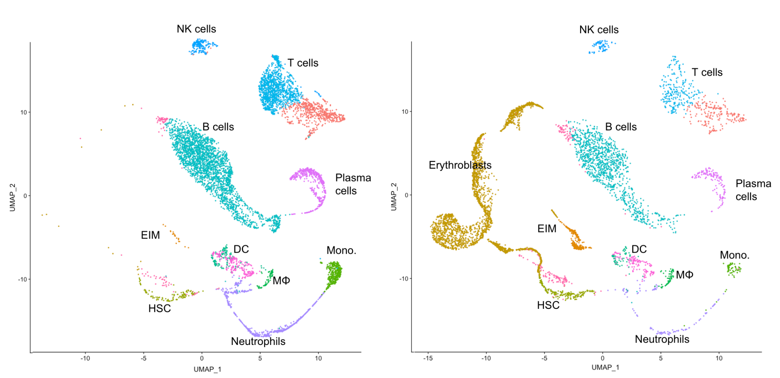
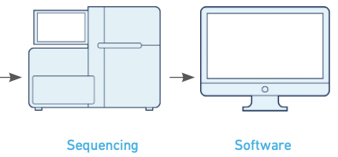
The Untold Story of RBC Lysis as Told By SCS
Spleen 1
Workflow
Analysis
RBC Lysis
Depleted
Spleen 2

Slide 18
Where Lysis Falls Short
Enucleation
Mature Erythrocyte
MEP
Proerythroblast
Erythroblast
Reticulocyte
RBC Lysis
RBC Depletion
RBC depletion targets a wider range of RBCs as compared to RBC lysis
Levitation Technology enables efficient and effective RBC removal while concurrently improving sample quality

Slide 19
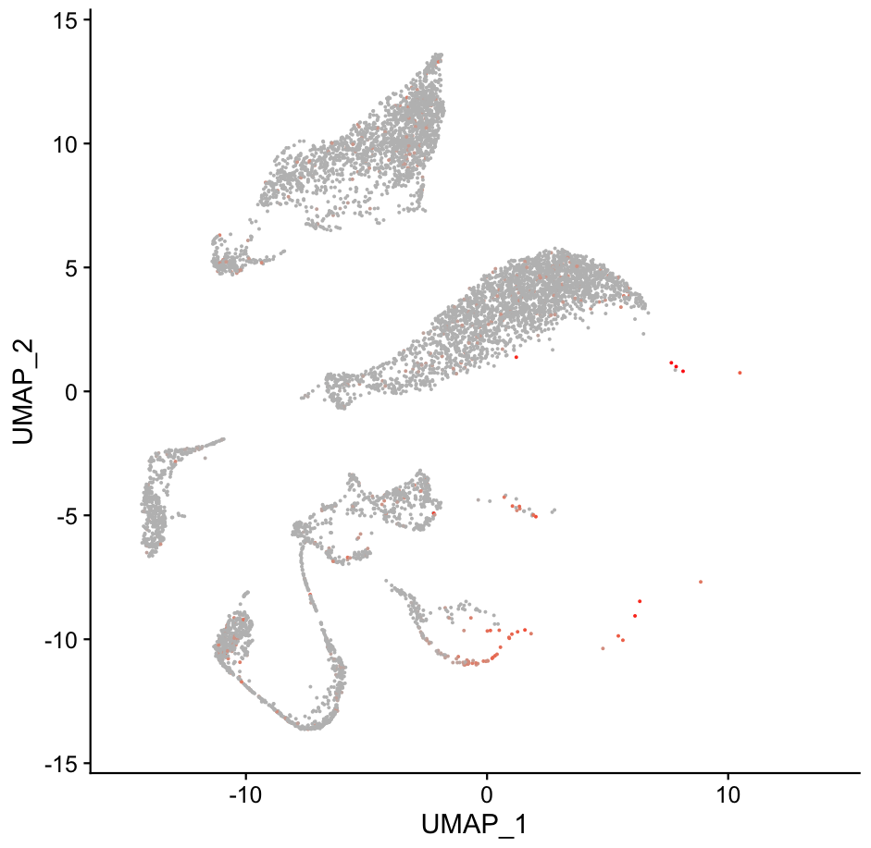
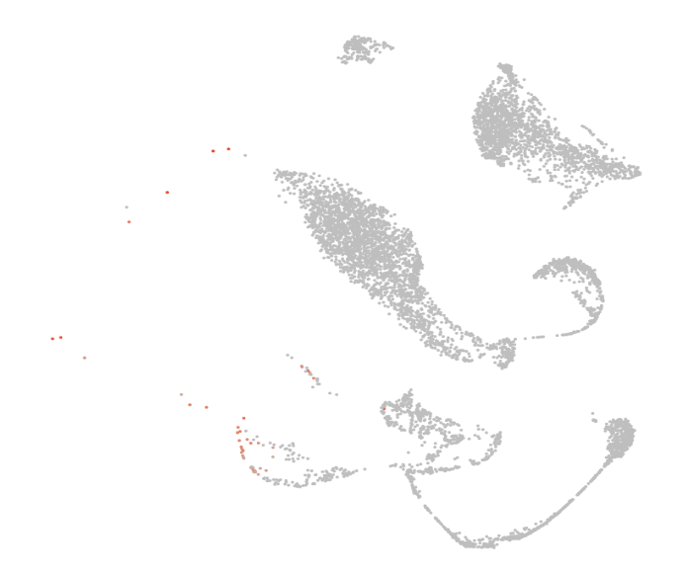
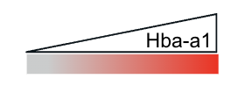
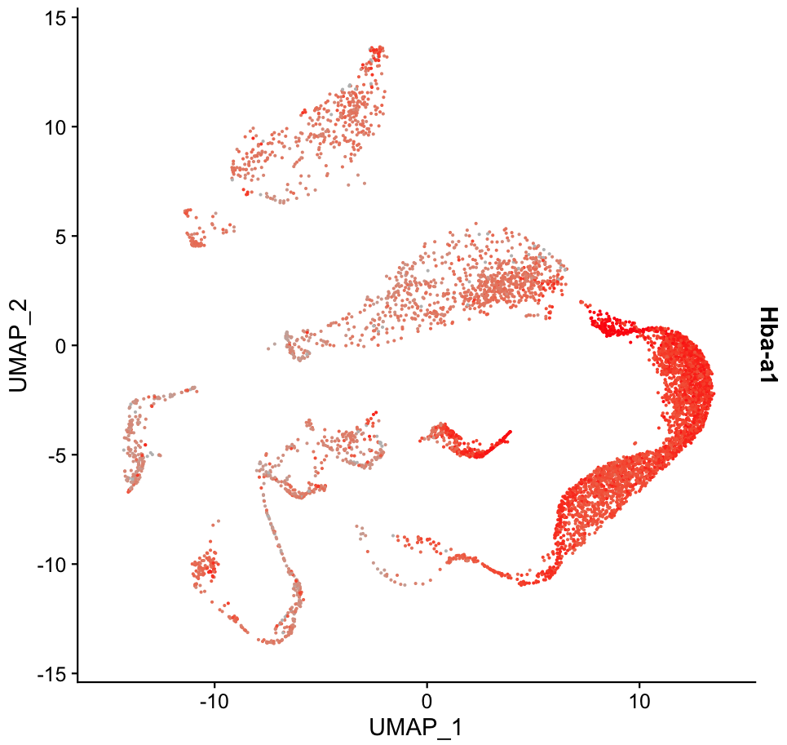
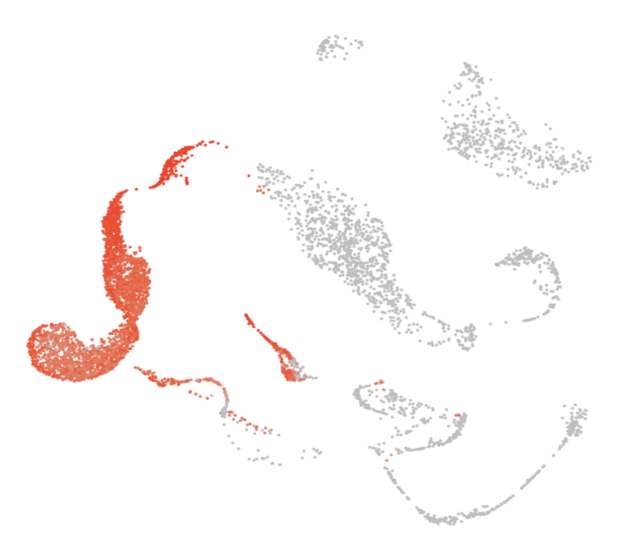
Increase Sequencing Resolution
With Ambient RNA
Without Ambient RNA
RBC lysis results in high-levels of ambient RBC-associated genes such as Hba-a1
Remaining contamination is the result of incomplete RBC lysis
RBC Depletion
Deplete debris, dead/dying cells, and RBCs simultaneously
Eliminate developing RBCs that are lysis-resistant
Improve resolution of target subpopulations and data quality
RBC Lysis
Notes:
Figure 1: RBC depletion eliminates ambient RNA contamination from RBC. Spleens from two separate C57/BL6 mice were dissociated and either treated with RBC depletion (A and C) or with hypotonic ammonium chloride solution to lyse RBC (B and D). Approximately 7500 cells from each preparation were analyzed by single cell RNA sequencing and the resulting data was subjected to dimensional reduction and gene expression analysis using Seurat. The resulting UMAPs are shown above with the expression levels of the RBC gene Hba-a1 superimposed in red (one representative spleen from each condition is shown). To highlight the amount of ambient RNA contamination contributed by RBC lysis, UMAPs are shown without bioinformatic subtraction of ambient RNA (A and B) and with ambient RNA subtraction with SoupX (C and D).

Slide 20
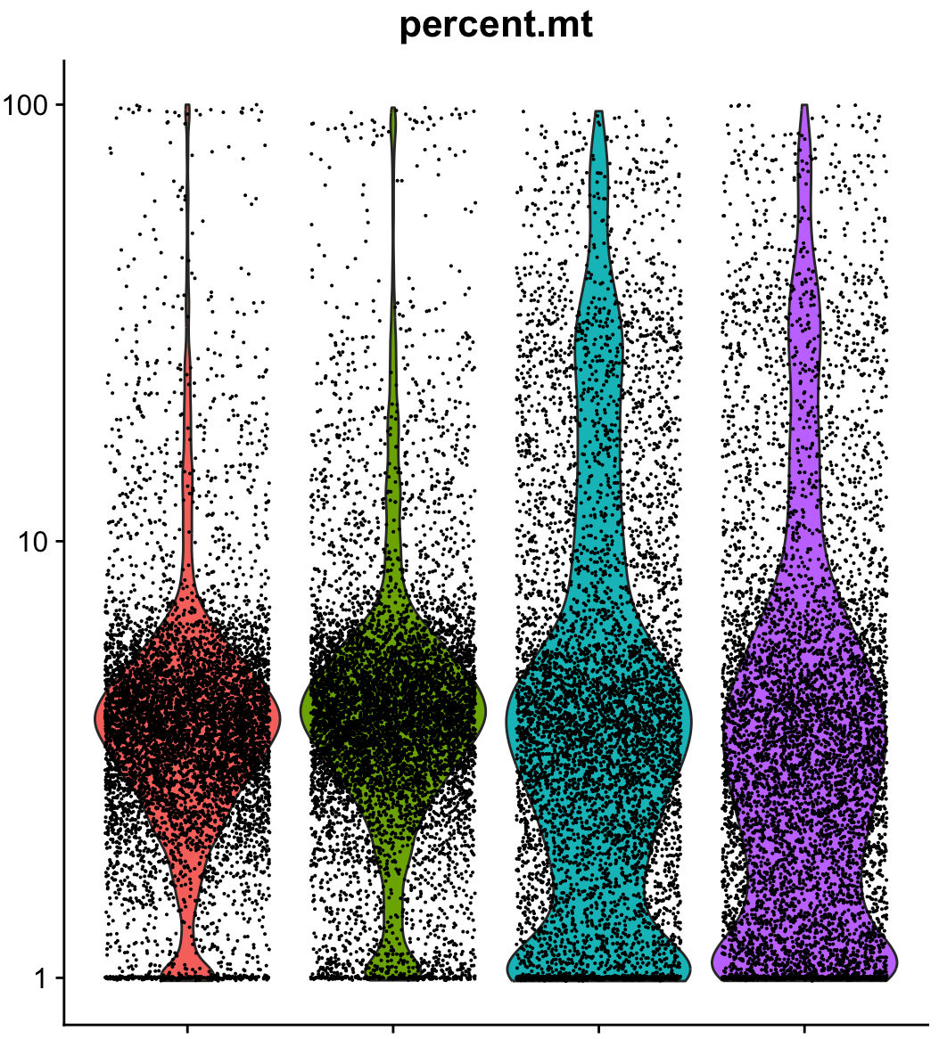
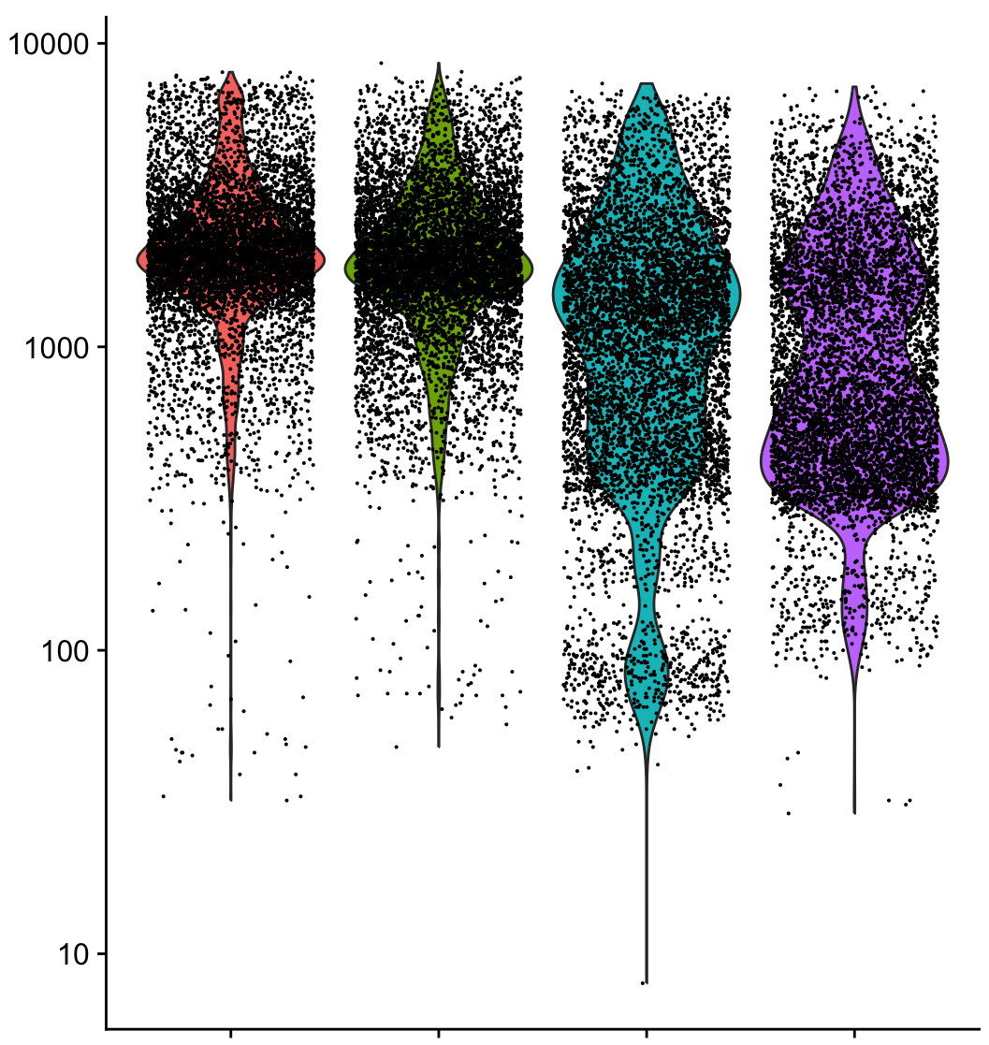
Improve Data Quality
# Features
% Mitochondrial Gene Expression
5.0%
6.6%
18.1%
13.7%
Increase # features
Reduce % of cells with high mitochondrial gene expression
Increased amount of usable data for analysis
0.7%
0.5%
4.7%
9.2%
RBC Depletion
RBC Lysis
RBC Depletion
RBC Lysis
Mouse Spleen
Mouse Spleen
Notes:
Figure 2. RBC depletion reduces the number of cell barcodes associated with low number of features and high mitochondrial gene expression. The number of features (left) and the % of that gene expression that can be attributed to mitochondria (right) is shown for the splenocyte single cell RNA sequencing data sets described in figure 1 (after removing ambient RNA and doublets bioinformatically). * Starred brackets indicate cell barcodes associated with low numbers of features and/or high % mitochondrial gene expression and so must be removed bioinformatically.

Slide 21
Increase Usable Data and Reduce Cost
% of Total Cells: | RBC Depletion |  | RBC Lysis
 | Spleen 1 | Spleen 2 | Spleen 1 | Spleen 2
Cells with < 200 features: | 0.5% | 0.7% | 9.2% | 4.7%
Cells with >10% mitochondrial reads: | 5.0% | 6.6% | 18.1% | 13.7%
Cells associated with both: | 5.1% | 6.6% | 25.9% | 16.9%
Increase gene detection for greater scientific insight
Retain data points to maximize sample potential
Reduce the wasted cost of unusable sequencing data
Notes:
Figure 2. RBC depletion reduces the number of cell barcodes associated with low number of features and high mitochondrial gene expression. The number of features (left) and the % of that gene expression that can be attributed to mitochondria (right) is shown for the splenocyte single cell RNA sequencing data sets described in figure 1 (after removing ambient RNA and doublets bioinformatically). * Starred brackets indicate cell barcodes associated with low numbers of features and/or high % mitochondrial gene expression and so must be removed bioinformatically.

Slide 22
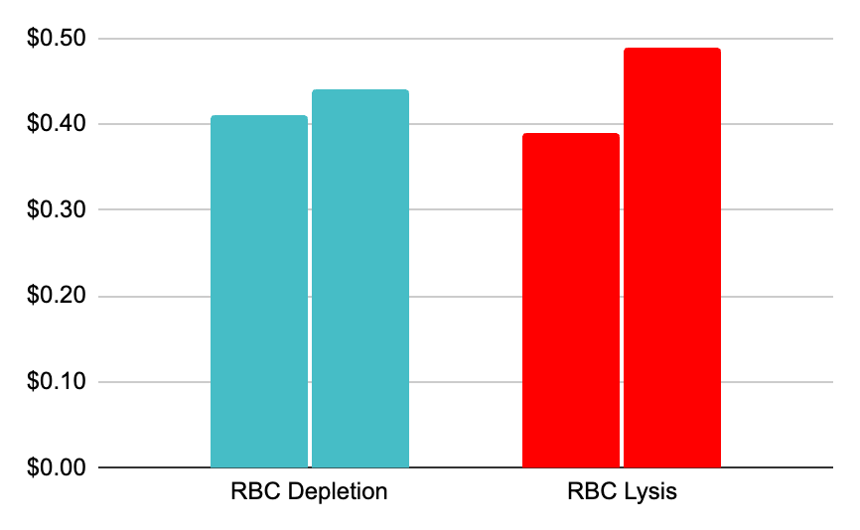
The Cost of Quality May Be Less Than You Think
Sequencing Cost/Cell
Cost Breakdown | RBC Depletion | RBC Lysis
LeviSelect Kit & Consumables | $120 | $5
Library Prep & Sequencing | $1,938 | $1,938
Total Cost | $2,058 | $1,938
Target Cells Sequenced | 5000
Theoretical Actual
Theoretical Actual
$.41
$.44
$.39
$.49
RBC depletion adds 6% to the total sequencing costs
Improves sample and data quality for $.02/cell
Notes:
LC 1.0: Cartridge ($90) + Lev. Agent ($10) + RBC Kit ($20) = $120/sample
EOS: Cartridge ($180) + Lev. Agent ($40) + RBC Kit ($80) = $300/4 samples = $75/sample
Sequencing Cost: 8 samples (5,000 cells each) = $2,500/8 = $312.50/sample
Assuming a 20% loss in usable sequencing data = $62.50/sample Cost of Depletion = $12.50
Assuming a 25% loss in usable sequencing data = $78.12/sample Cost of Depletion = $-3.50
Process nearly or completely pays for itself depending on sample quality

Slide 23
Maximize Resolution and Cost Efficiency
RBC Depletion
RBC Lysis
Removes both progenitor and mature RBCs
Maximizes resource expenditure and time
Improves data resolution for downstream analysis
Notes:
Figure 3. RBC depletion provides better representation of non-RBC-related cell types as compared to conventional RBC lysis. Cell clusters were identified using ScType and the UMAPs are shown for spleen #2 with RBC depletion (A) or RBC lysis (B). The total cell numbers for each cell type are shown for each spleen and condition (C), revealing the over-representation of RBC-related cells in samples treated with RBC lysis. Hemoglobin gene expression is shown for each cell type without (D) and with (E) bioinformatic subtraction of ambient RNA. EIM, erythroblastic island macrophages; MΦ, macrophages; DC, dendritic cells, Mono., intermediate monocytes; HSC/MPP, hematopoietic stem cells/ multipotent progenitor cells.

Slide 24
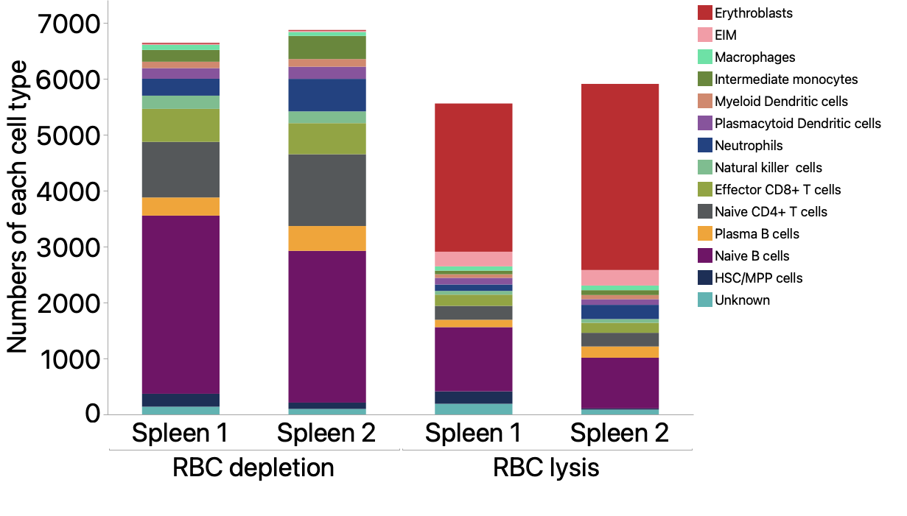
Bring True Biological Signatures into Focus
Remove lysis-resistant erythroblasts and mature RBCs
Recover representative target cell subpopulations
Gentle process minimizes processing-related artifacts
Notes:
Figure 3. RBC depletion provides better representation of non-RBC-related cell types as compared to conventional RBC lysis. Cell clusters were identified using ScType and the UMAPs are shown for spleen #2 with RBC depletion (A) or RBC lysis (B). The total cell numbers for each cell type are shown for each spleen and condition (C), revealing the over-representation of RBC-related cells in samples treated with RBC lysis.

Slide 25
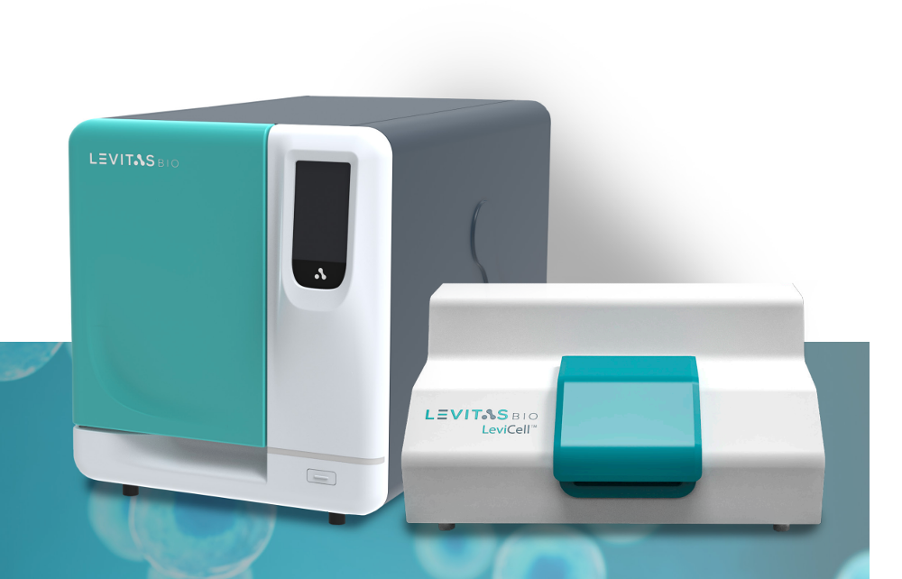
Maximize Sample Preparation with Levitation Technology
Simplified, combinatorial workflow
Fast, gentle and semi-automated process
Exceptional RBC depletion from a variety of human and mouse tissues
Remove debris and increases viability
Improve experimental accuracy
Maximize resources and samples
For Research Use Only. Not for use in diagnostic procedures. ©2024 LevitasBio, Inc. All rights reserved. LeviCell, LeviSelect, Levitation Technology and the LevitasBio logo are trademarks of LevitasBio, Inc. sales@levitasbio.com 90-00283A0324
Notes:
Levitation Technology can now be leveraged to deplete RBCs from a variety of human and mouse tissues.

