Slide 1
The LevitasBio Nuclear Revolution
90-00300

Slide 2
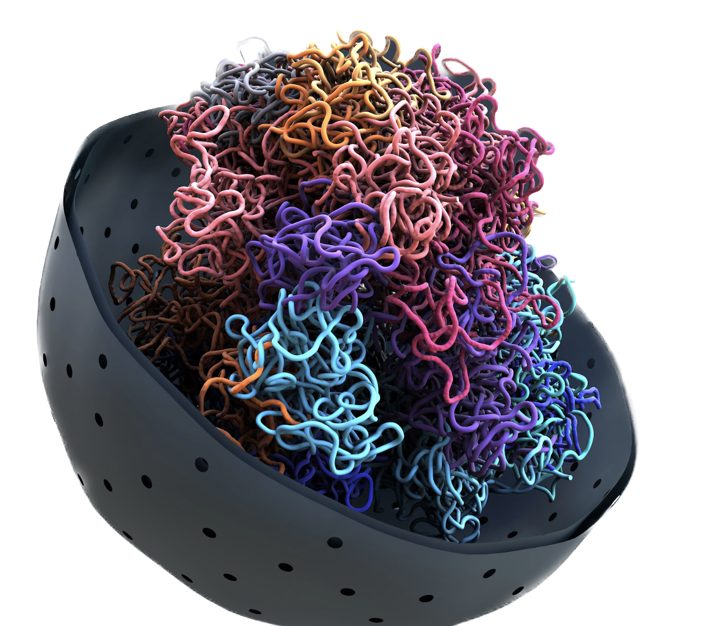
Advantages of Research Using Nuclei
Grants access to difficult samples
Removes transcriptional noise from dead/dying cells
Preserves the native cellular state
Provides insight into epigenetics
Notes:
Abstract
Single-cell genomics is essential to chart tumor ecosystems. Although single-cell RNA-Seq (scRNA-Seq) profiles RNA from cells dissociated from fresh tumors, single-nucleus RNA-Seq (snRNA-Seq) is needed to profile frozen or hard-to-dissociate tumors. Each requires customization to different tissue and tumor types, posing a barrier to adoption. Here, we have developed a systematic toolbox for profiling fresh and frozen clinical tumor samples using scRNA-Seq and snRNA-Seq, respectively. We analyzed 216,490 cells and nuclei from 40 samples across 23 specimens spanning eight tumor types of varying tissue and sample characteristics. We evaluated protocols by cell and nucleus quality, recovery rate and cellular composition. scRNA-Seq and snRNA-Seq from matched samples recovered the same cell types, but at different proportions. Our work provides guidance for studies in a broad range of tumors, including criteria for testing and selecting methods from the toolbox for other tumors, thus paving the way for charting tumor atlases.
Main
Tumors encompass complex cellular ecosystems of malignant and non-malignant cells, whose diversity and interactions affect cancer progression and drug response and resistance. Recent advances in single-cell genomics, especially single-cell RNA-Seq (scRNA-Seq), have transformed our ability to analyze tumors, revealing cell types, states, genetic diversity and interactions in the complex tumor ecosystem1,2,3,4,5,6. Single-cell analysis of tumors is rapidly expanding, including the launch of a Human Tumor Atlas Network (HTAPP) as part of the Cancer Moonshot7.
Successful scRNA-Seq of clinical tumor specimens poses several challenges. First, it requires quick dissociation tailored to the tumor type, and involves enzymatic digestion, which can lead to loss of sensitive cells or changes in gene expression. Moreover, obtaining fresh tissue is time-sensitive and requires tight coordination between tissue acquisition and processing teams, posing a challenge in clinical settings. Conversely, single-nucleus RNA-Seq (snRNA-Seq) allows profiling of single nuclei isolated from frozen tissues, decoupling tissue acquisition from immediate sample processing. snRNA-Seq can also handle samples that cannot be successfully dissociated even when fresh, due to size or cell fragility8,9, as well as multiplexed analysis of longitudinal samples from the same individual10. However, nuclei have lower amounts of mRNA compared to cells and are more challenging to enrich or deplete for specific cell types of interest. Both scRNA-Seq and snRNA-Seq pose experimental challenges when applied to different tumor types, due to the distinct cellular composition and extracellular matrix (ECM) in different tumors, and thus each assay requires dedicated customizations11.
To address these challenges, we developed a systematic toolbox for fresh and frozen tumor processing using scRNA-Seq and snRNA-Seq, respectively (Fig. 1a). The toolbox contains our experimental workflow and methods, computational pipelines and evaluation metrics. To generalize across tumor and sample types, we tested eight tumor types with different tissue characteristics (Fig. 1b), including comparisons of matched fresh and frozen preparations from the same tumor specimen. Our work provides direct recommended protocols for multiple tumor types, decision trees that allow researchers to choose the most suitable protocol for their research goals, and guidelines on how to customize protocols for new tumor and specimen types.

Slide 3
General Nuclei Workflow
Common Sample Types
Isolated Nuclei
Downstream Assays
Frozen & Archived Tissues
Low-Quality Samples
Sensitive Cell Types
Bulk Sequencing
Single Nuclei Sequencing
ATAC/Multiome

Slide 4
Challenges that Arise from Processing Nuclei
General Nuclei Isolation Workflow
Extraction
~ 30 min
Enrichment
~ 20-90 min+
Quality Control
~15 min
Protocol variation & effectiveness
Buffers can be harsh on nuclei integrity
Time-sensitive process
Considered as an optional step
Often require some technical skill
Considerable time, variability & resources spent on the process
Subjective qualitative assessment
Complicated by debris & aggregates
Counting accuracy is problematic
Proprietary protective agent in extraction buffer
Simplified workflow with minimal technical requirements
Effective debris and aggregate removal for accurate counting

Slide 5
Be More Confident with Higher-Quality Sequencing Data
Results
Benefits
High yield from samples
Gain access to sensitive, complicated, and high bar assays
Efficient removal of debris
Reduce ambient background noise in quality control and bioinformatics
High percentage of singlets
Increase counting accuracy and obtain true sn-sequencing data sets
High-quality nuclei
Excellent sequencing results and more usable data

Slide 6
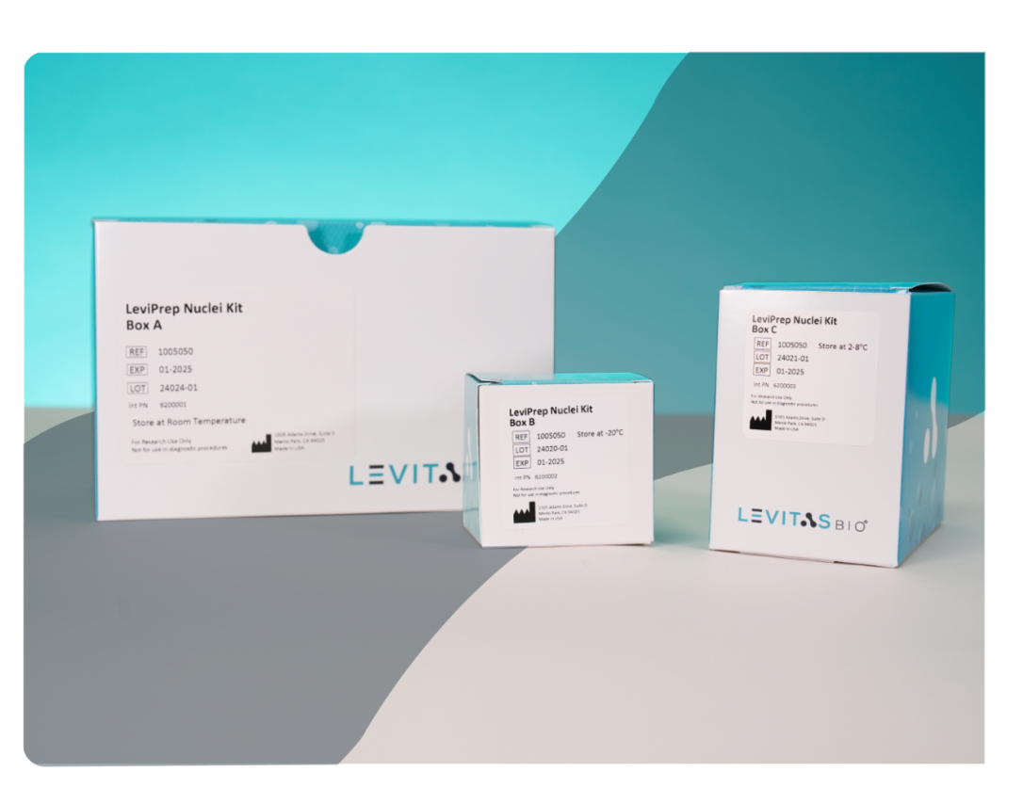
Novel Approach for Nuclei Enrichment
LeviPrep Nuclei Kit II
Gently obtain healthy, single nuclei, that are free of excessive debris and background noise. Our optimized kit provides the excellent yield and quality required for sensitive downstream sequencing.
Temperature controlled options
Suitable for 20-50 mg of tissue
16 reactions per kit

Slide 7
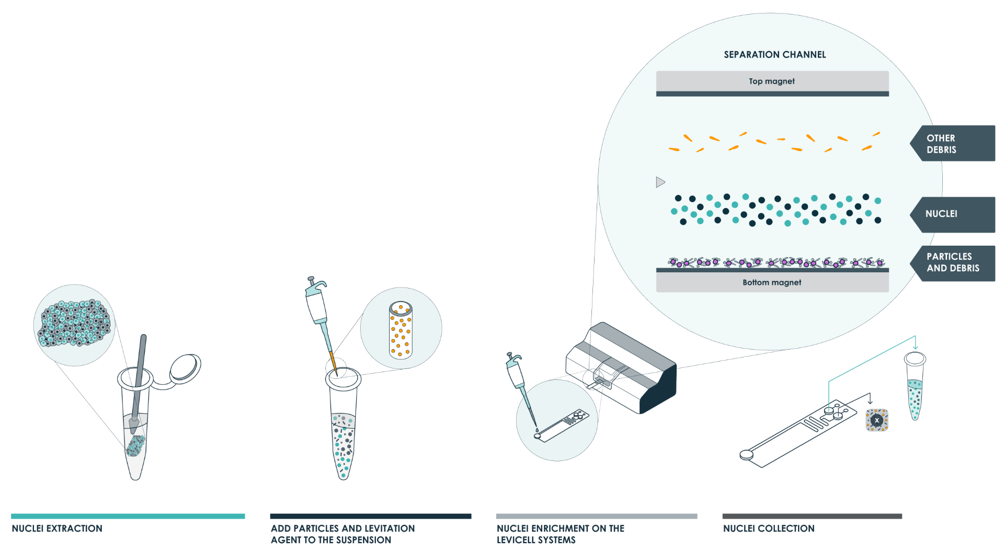
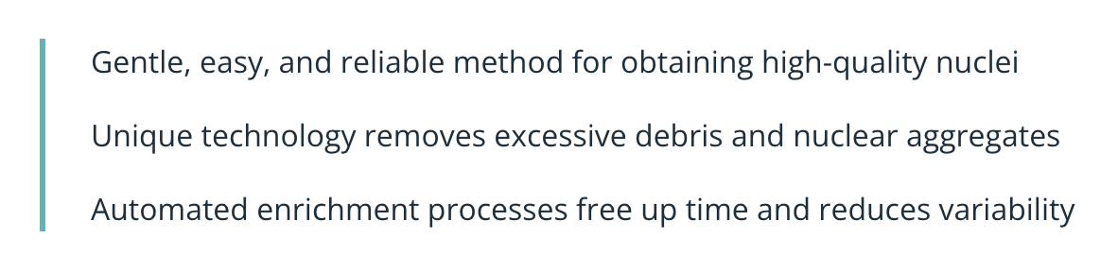
Reduce Extra Steps & Wasted Resources
Proprietary extraction method
Fast & efficient with only four steps
Consistent & reproducible process

Slide 8
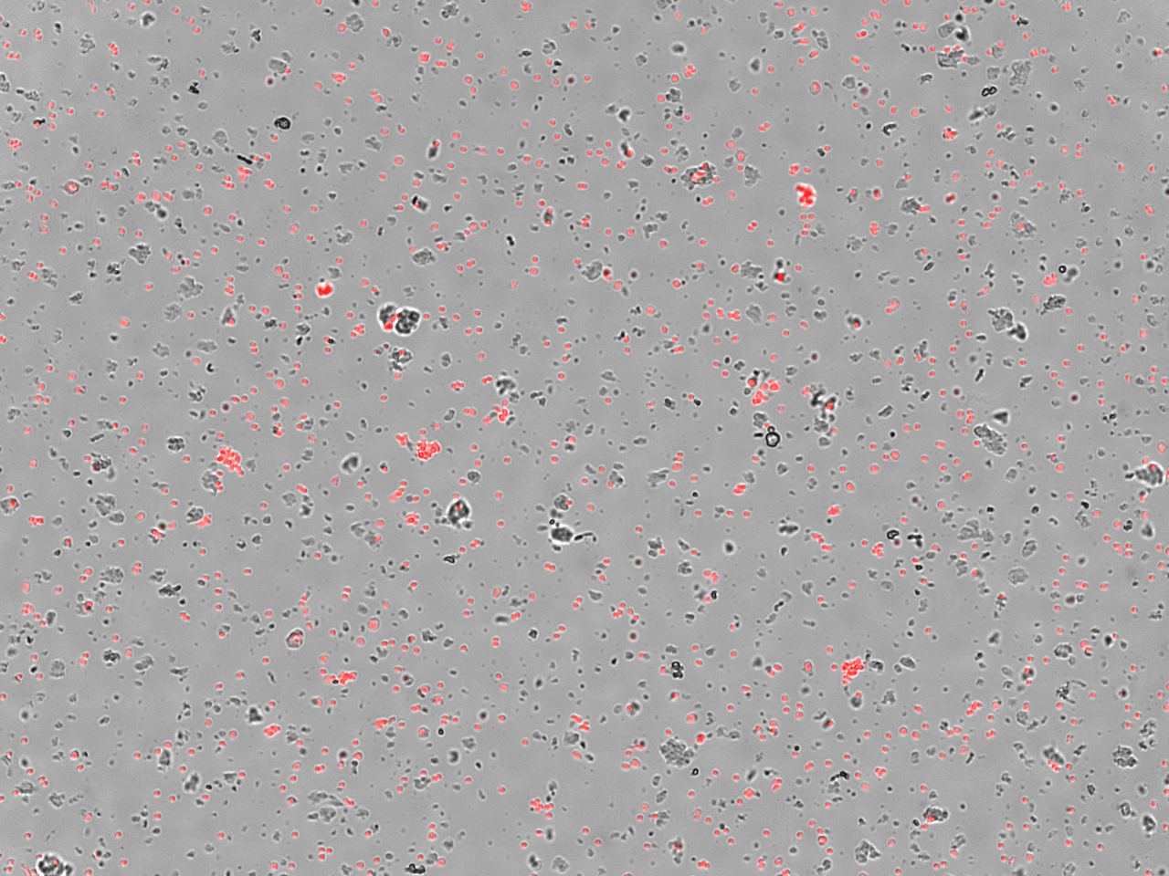

Exceptional Sample Cleanup
Mouse Brain
Input
Output
Isolate uniform & intact nuclei
Remove debris & nuclear aggregates

Slide 9
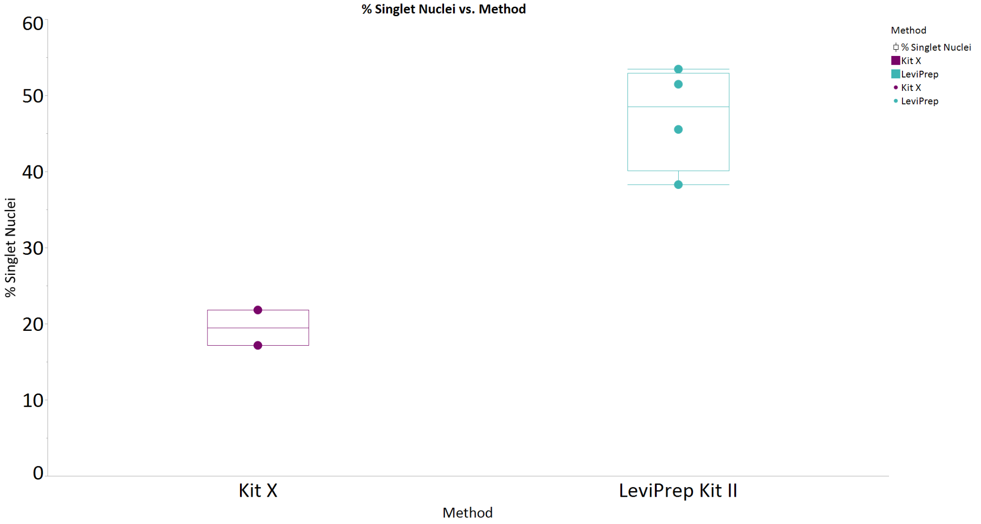
Get 2X the Amount of Single Nuclei
Mouse Brain
60%
50%
40%
Enrich for more singlets than a leading competitor’s kit
Improve counting accuracy
Obtain true single-nuclei data
% Single Nuclei
30%
20%
10%
0%

Slide 10
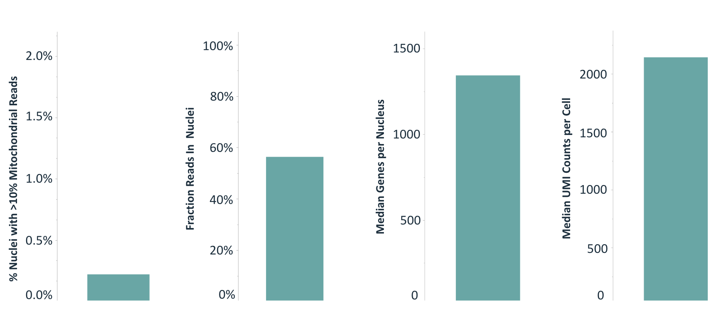
Obtain High-Quality Sequencing Results
Mouse Brain
Reduce low-quality indicators like high mitochondrial reads, low fraction of reads, or inadequate median genes or UMI counts

Slide 11
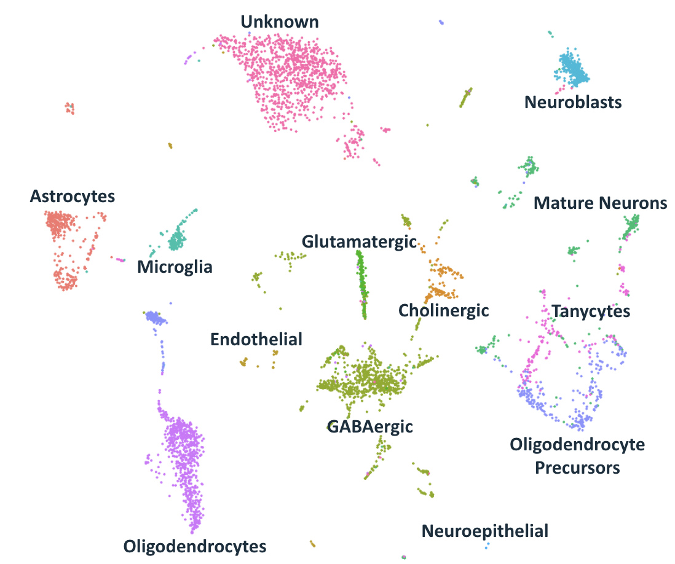
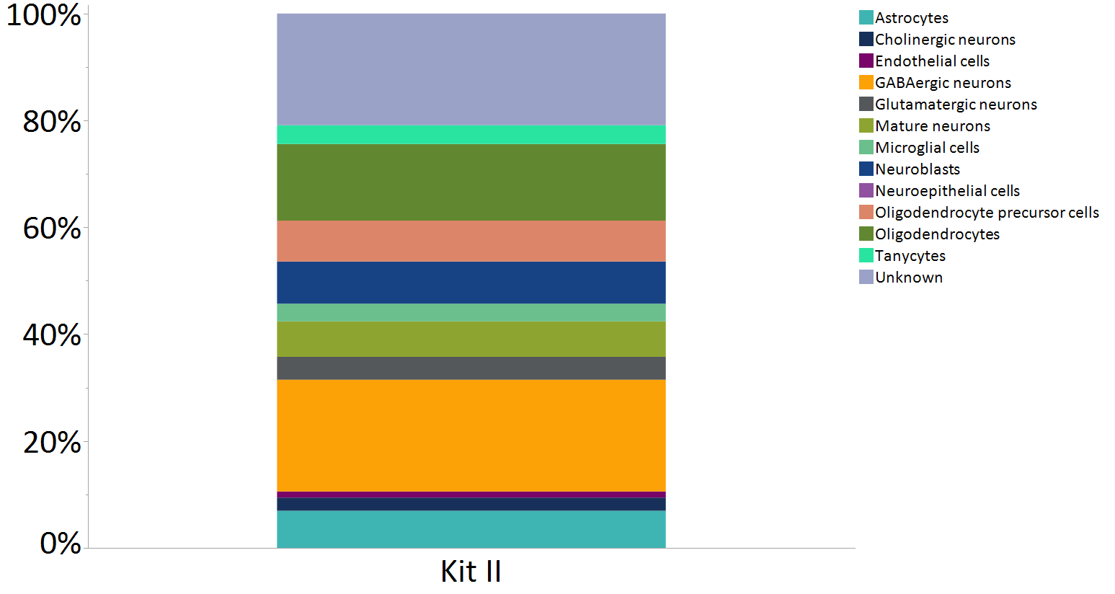
Improve Resolution of Target Populations
Mouse Brain
% Cell Population
Generate representative sub-population ratios
Improve sequencing resolution and quality
Reduce filtering and increase confidence in data
*Mouse Brain
Notes:
Sample is flash frozen mouse brain: 25 & 37 mg.Target was 5000 nuclei. Recovery is 8,934 for one and 5,068 for the other. I'm guessing these are the initial 2 runs with the new Particle M

Slide 12
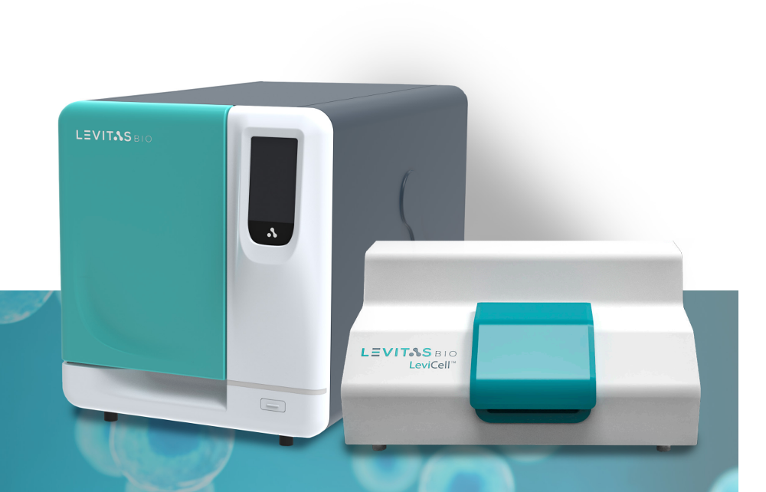
Raising the Bar for Nuclei Extraction & Enrichment
Simple, Semi-Automated Workflow
Fast, Gentle & Consistent Process
Efficient Removal of Debris
Generates More Single Nuclei
Improves Sample & Data Quality

