Slide 1
No Effect of Particle C Carry-Over on snRNA-Seq Data Quality

Slide 2
LeviPrep Nuclei Kit Particle C Carryover Has No Effect on snRNA-Seq
Nuclei isolated with the LeviPrepTM Nuclei Kit often contain residual Particle C which can be seen during cell count or flow analysis
This residual Particle C has no impact on the ability to generate cDNA or final, amplified library using 10x 3’ chemistry
Single nuclei sequencing metrics examined are improved, or are at least equivalent, in the nuclei preps that contained residual Particle C compared to alternative methods that do not use Particle C

Slide 3
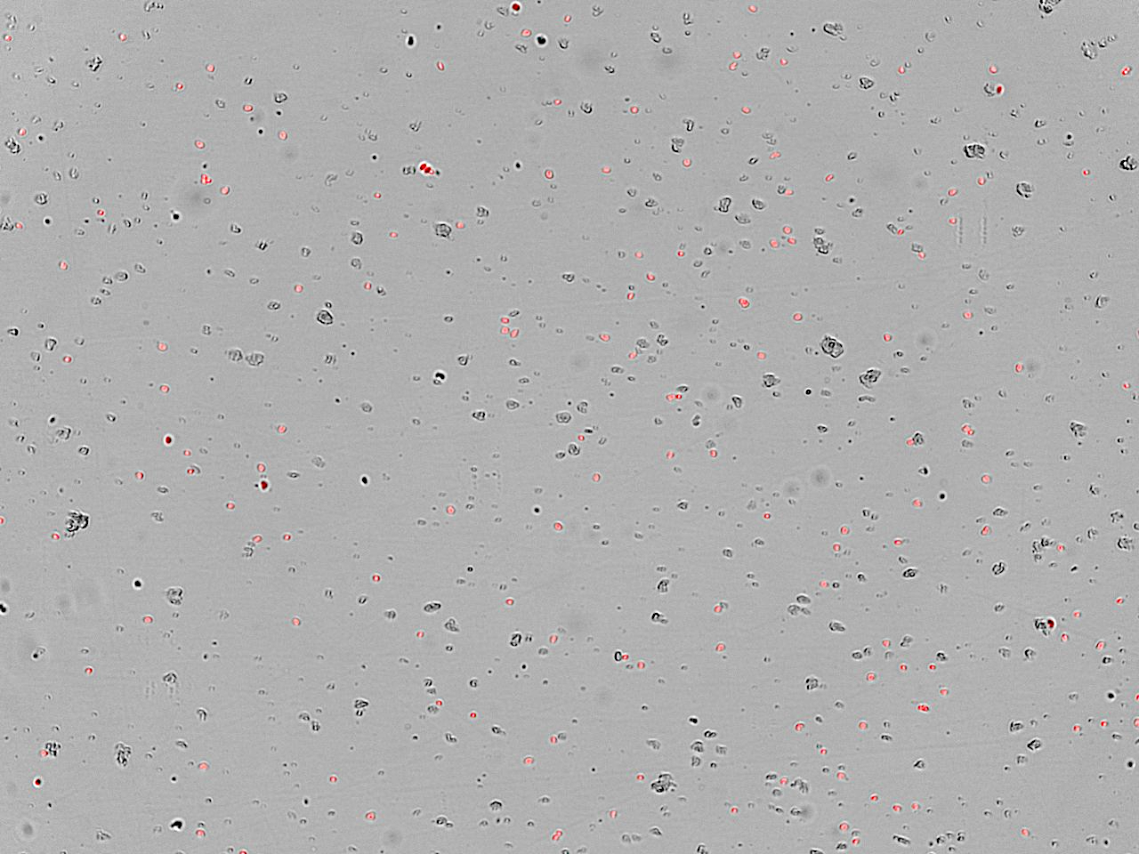
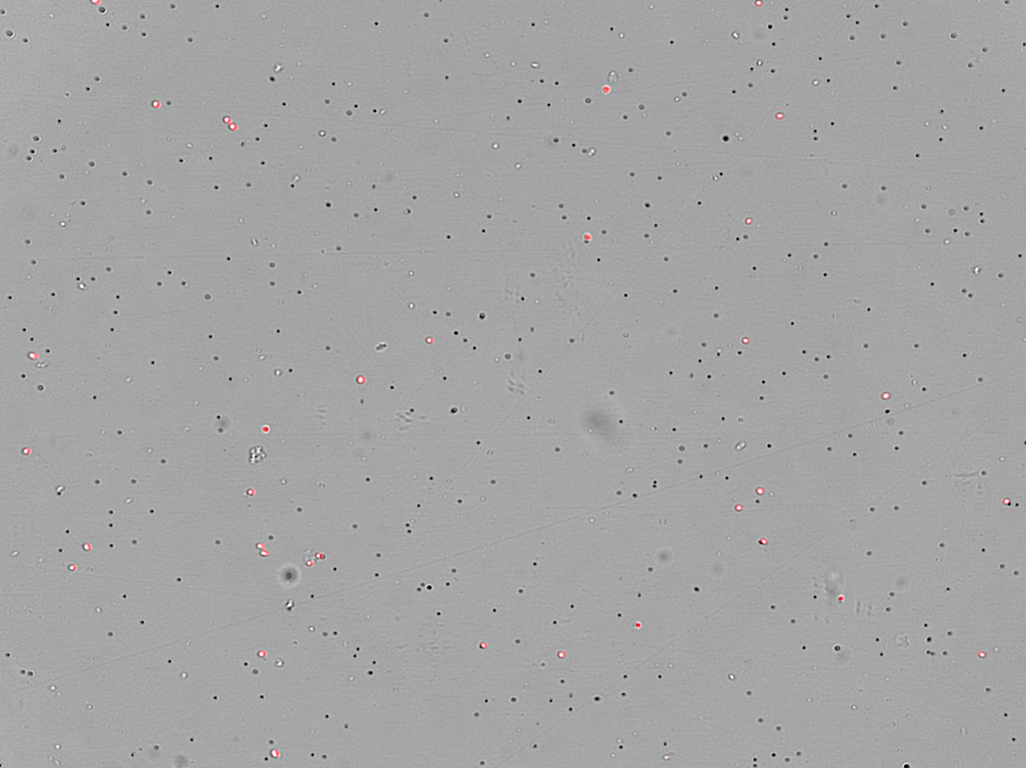
Clear Discrimination of Round Nuclei, Debris, and Particle C
Kit X
Nuclei are stained red in all images
Debris and Particle C do not stain red
Debris can be seen in the Kit X sample post-extraction
Particle C is seen in the LeviPrep Nuclei Kit sample post-levitation
Particle C can be distinguished from debris and nuclei using fluorescent stains
PI staining is recommended for counting
LeviPrep Nuclei Kit

Slide 4
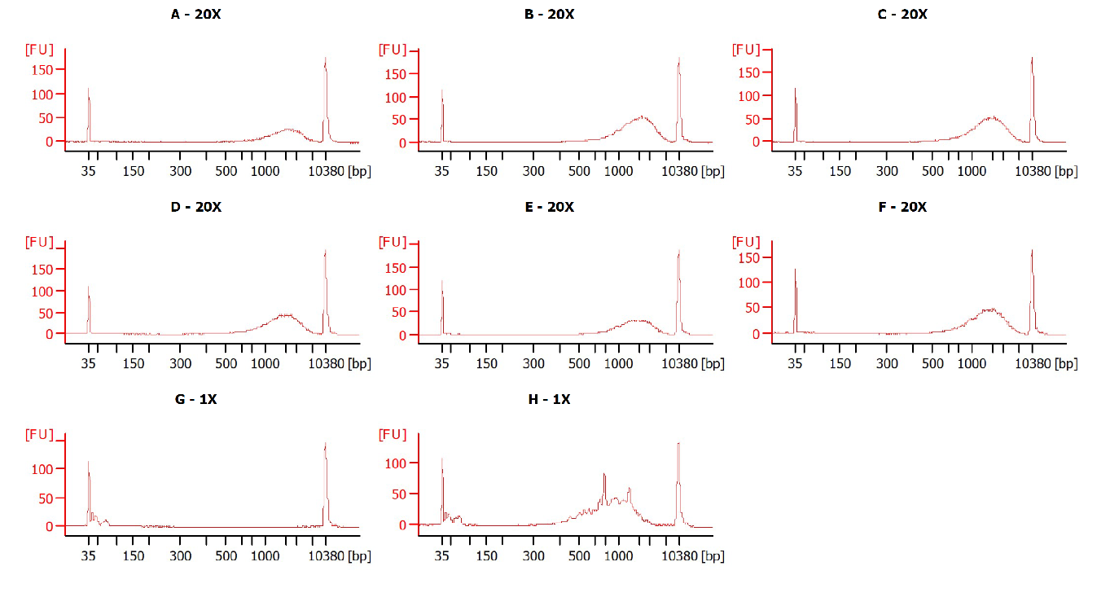
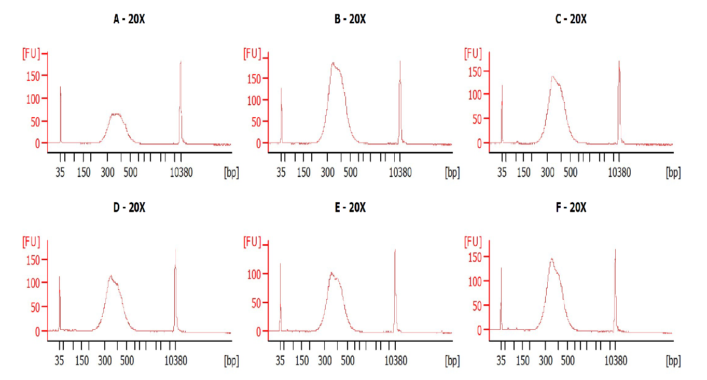
cDNA & Library Prepared With 10x Chromium v3.1 3’RNA Kit Unaffected by Particle C
cDNA
Final Library
Kit X
No Particle C
LeviPrep Nuclei Kit
w/ Particle C
Identical profiles for both cDNA and final library regardless of presence of Particle C

Slide 5
Particle C Carry-Over Shows No Impact on Sequencing QC Metrics
QC metrics equivalent or better in the presence Particle C
More consistent targeting of expected cell number
Very low mitochondrial read contamination
target

Slide 6
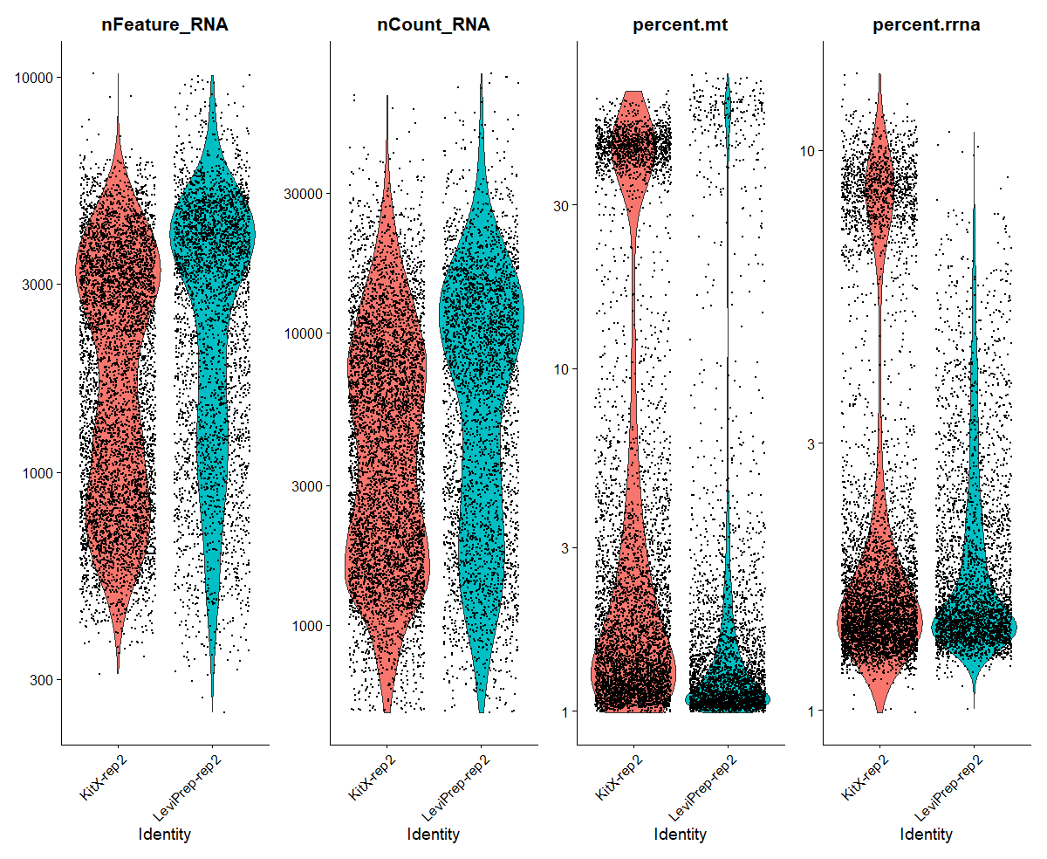
Particle C Does Not Negatively Affect Single Nuclei RNA-Seq Metrics
LeviPrep Nuclei Kit improves sequencing metrics with more quality nuclei
Higher RNA counts
Higher numbers of genes detected
Less contaminating mitochondrial and rRNA reads
Kit X
Kit X
Kit X
Kit X
LeviPrep
LeviPrep
LeviPrep
LeviPrep

Slide 7
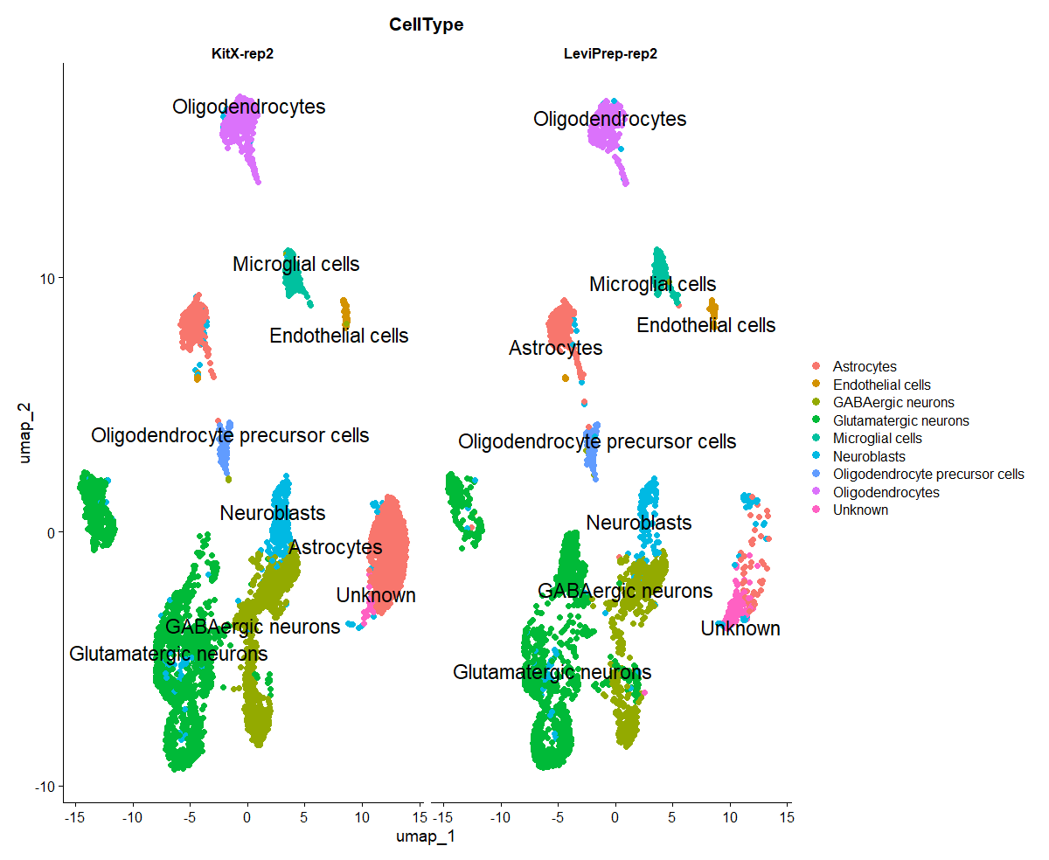
All Expected Cell Types Detected With Both Kits
Kit X
LeviPrep Nuclei Kit
Cell Number Distribution
Cell Type | Kit X | LeviPrep
Astrocytes | 29% | 8%
Endothelial cells | 1% | 2%
GABAergic neurons | 18% | 17%
Glutamatergic neurons | 31% | 43%
Microglial cells | 3% | 5%
Neuroblasts | 7% | 7%
Oligodendrocyte precursor cells | 2% | 3%
Oligodendrocytes | 8% | 8%
Unknown | 0% | 6%

Slide 8
Conclusions
LeviPrep Nuclei Kit performed well compared to “Kit X”
Estimated cell (nuclei) number is closer to target cell (nuclei) number
Shown to have less mitochondrial contamination
Yields more UMI/nuclei than nuclei prepped by “Kit X” method
Equivalent fractions reads in cells (nuclei), and mapping state
Particle C carryover does not affect 10x sequencing data quality

