Slide 1
Overcoming the Challenges of Organoid Research and Development
#90-002850424
Notes:
Good morning everyone. I’d like to take a few minutes to walk you through the recently created organoid customer facing presentation, which will hopefully facilitate future discussions about how levitation technology can help scientists with their organoid research, hence the title of the opening slide.

Slide 2
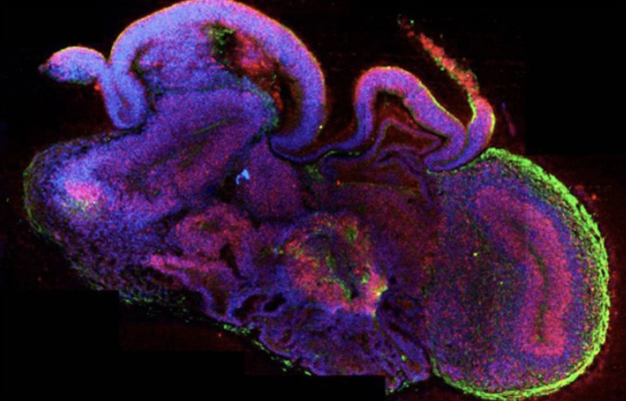

Leveraging Organoids to Advance Human Health
Modeling of tissue growth and homeostasis
Understand host-microbe interactions
Drug discovery and biobanking
Recapitulate disease pathology
Notes:
Organoids are used to study a wide variety of scientific applications, and some of these include the modeling of tissue growth and homeostasis, they help us to understand crucial host-microbe interactions, facilitate the drug discovery process, and can be used to recapitulate disease pathology. So where do organoids come from and where does our technology fit into a typical workflow?

Slide 3
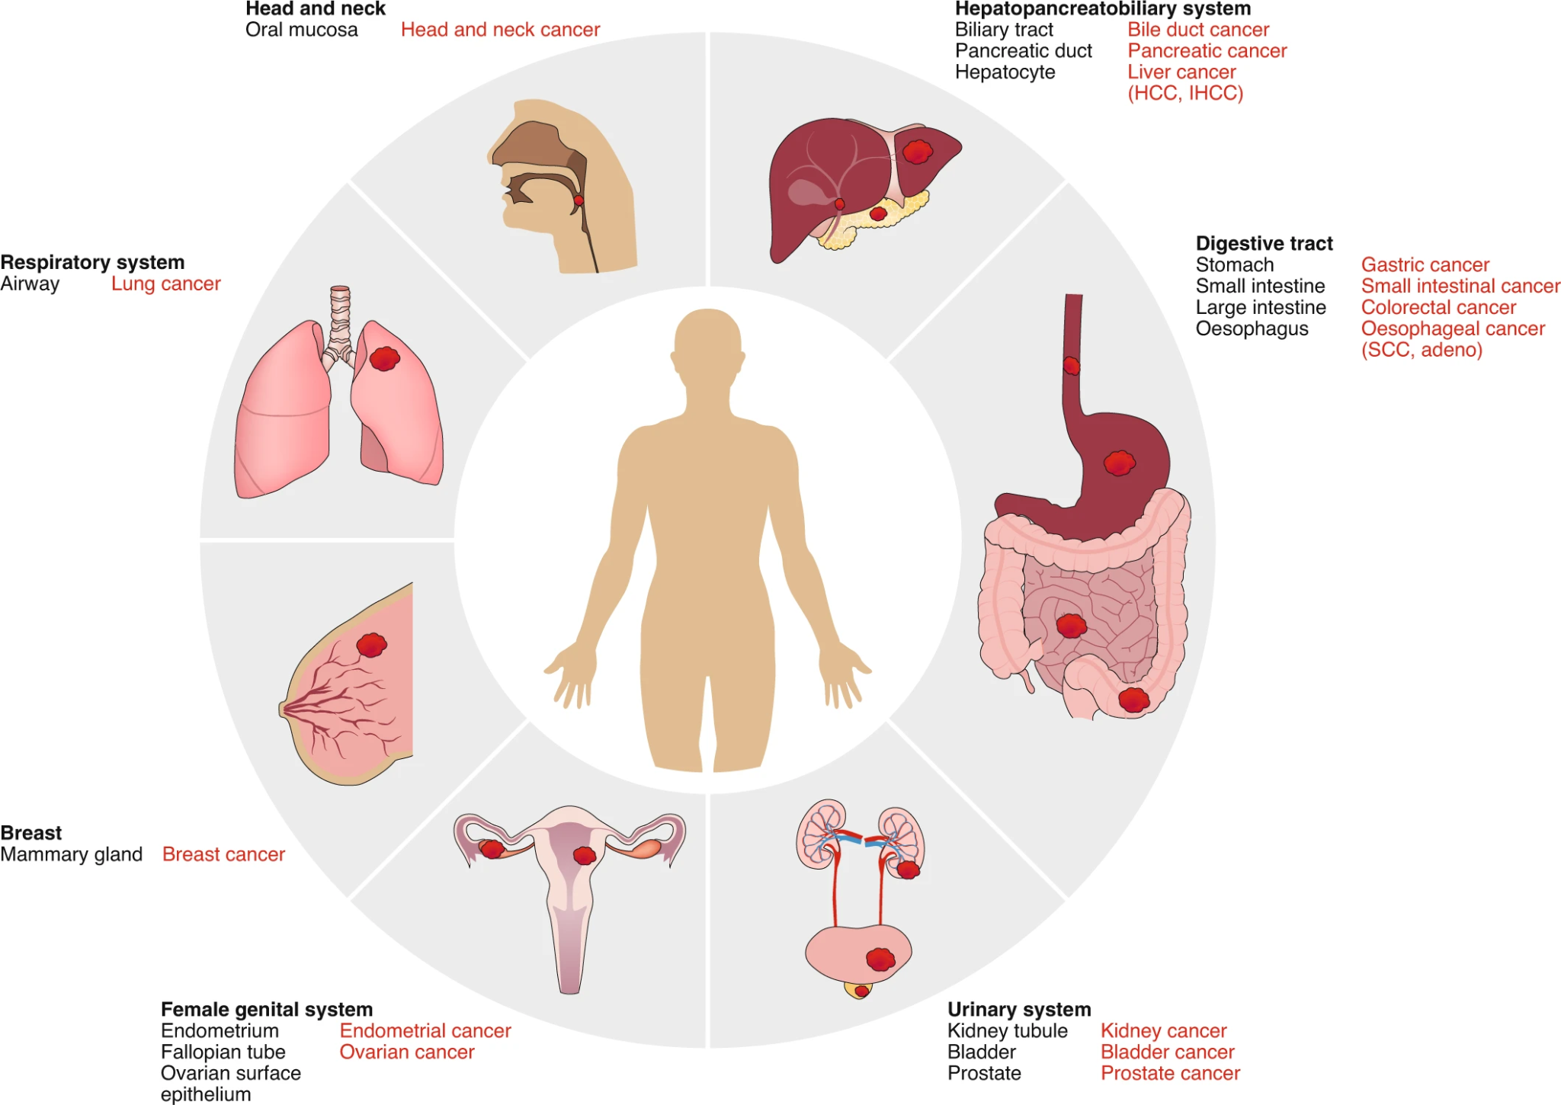
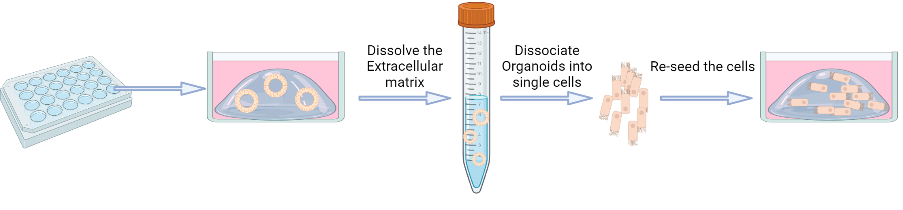
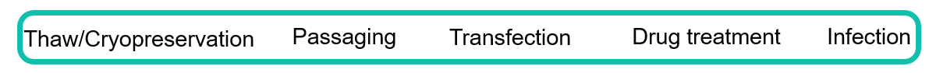

Common Organoid Origins and Applications
Primary tissue
iPSCs
Cryopreserved lines
iPSCs
Notes:
Organoids can be derived from a variety of sources, and these include primary tissues such as shown by the image on the left. Organoids can also be derived from iPSCs, and many organoids have been cryogenically preserved for future use without the need for the initial generation. Independent of where they come from, organoids are often subjected to a variety of processing and experimental conditions including thawing and freezing, passaging, transfection, drug treatment and infectious agents.

Slide 4
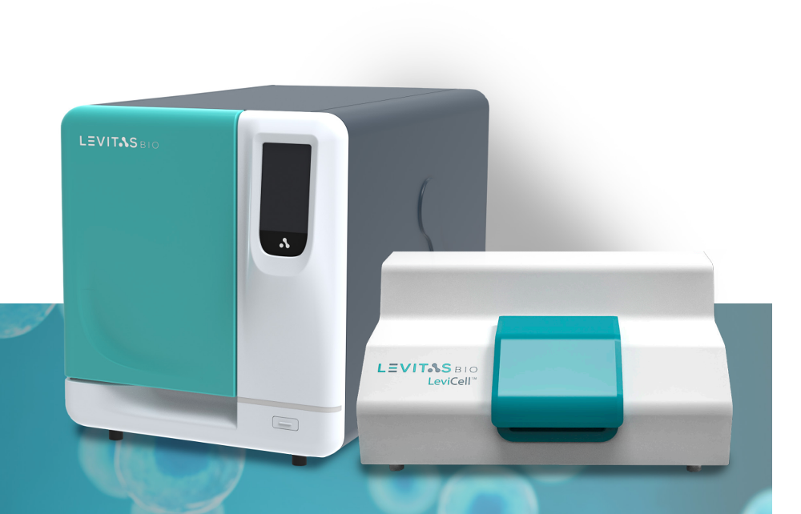
Enabling Efficient Organoid Processing and Maintenance
Processing Challenges
LevitasBio Solutions
Removal of unhealthy cells
Unwanted cell types that contaminate culture
Dissociation requirements for sorting of cells
Efficient regeneration of organoids post-processing
Enriches for healthy, viable cells and removes debris
Gentle processing for sensitive organoids
No dissociation required
Facilitates organoid generation after processing
Removal of unhealthy cells
Unwanted cell types that contaminate culture
Dissociation requirements for sorting of cells
Efficient regeneration of organoids post-processing
LeviCell® Systems
Notes:
Each of these processes have their own challenges such as the efficient and effective removal of unhealthy and/or unwanted cells that can contaminate the culture, the need to dissociate organoids for sorting and enrichment steps, and the efficient regeneration of healthy organoids post-processing….and this is where we come into play. Levitation Technology enables researchers to enrich for healthy, viable cells, which are free of major debris and dead cell contaminants. As you know, the process is very gentle on the cells, and due to the large size of the cartridge, no dissociation of the organoids of interest is required when enriching for cells of interest (though the technology is compatible with both whole and dissociated organoids). Aside from facilitating the processing of organoids, levitated samples improve scientist’s ability to regenerate cultures for future downstream readouts and subsequent storage and use.

Slide 5
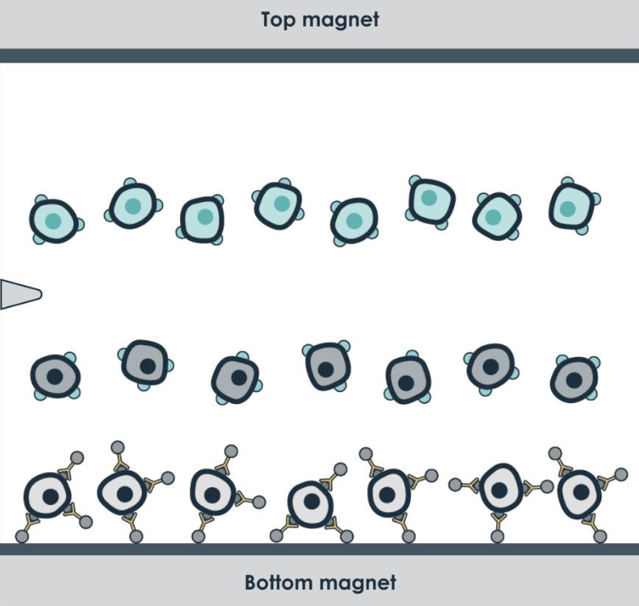


Elegant Simplicity
Viable cells levitate above the split line
Debris and dead cells fall below the split line
Simple, simultaneous, and semi-automated enrichment
Wide separation channel handling up to 350 μm
Gentle flow <1 psi
Live Whole Organoids
Split Line
Dead Cells/Debris
Notes:
This slide simply depicts the levitation process, and is described in a little more detail in the following slides….

Slide 6
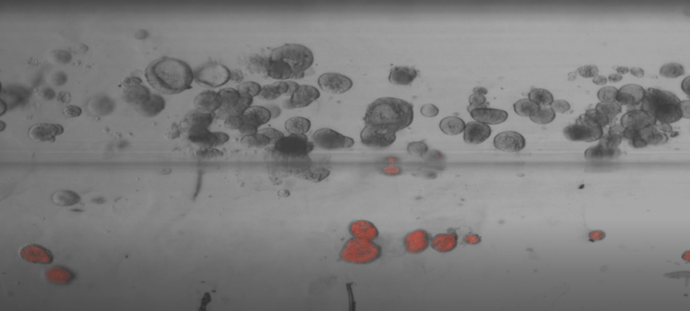
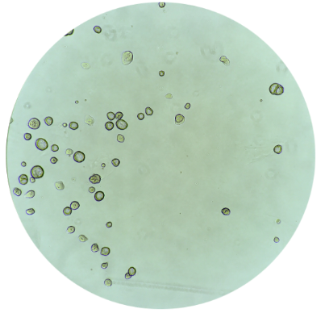
Levitating Healthy Organoids
Human Gastric Organoids
Live Organoids
Dead Organoids
Gentle process reduces processing stress
No dissociation required for enrichment
Simple and rapid process
No need for antibodies or dyes
Notes:
Here we show internally generated data, demonstrating how one can visualize the levitation process and how dead and dying orgaoids (along with debris) levitate towards the bottom of the cartridge, allowing researchers to easily and rapidly enrich for viable, whole organoids without the need of dyes or antibodies.

Slide 7
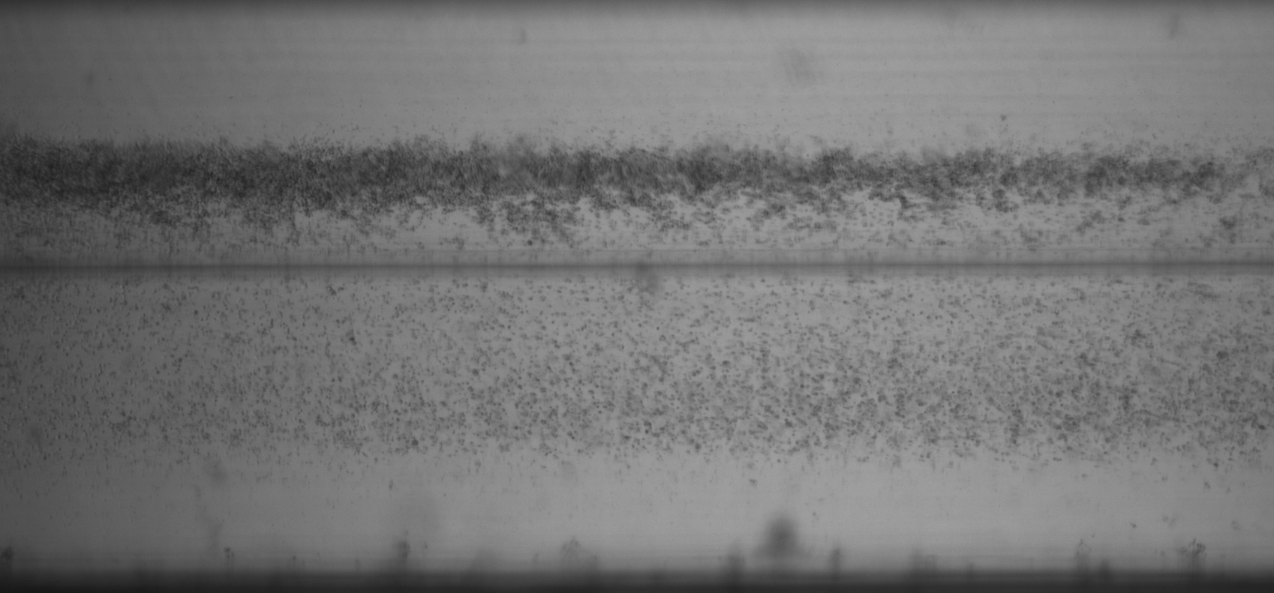
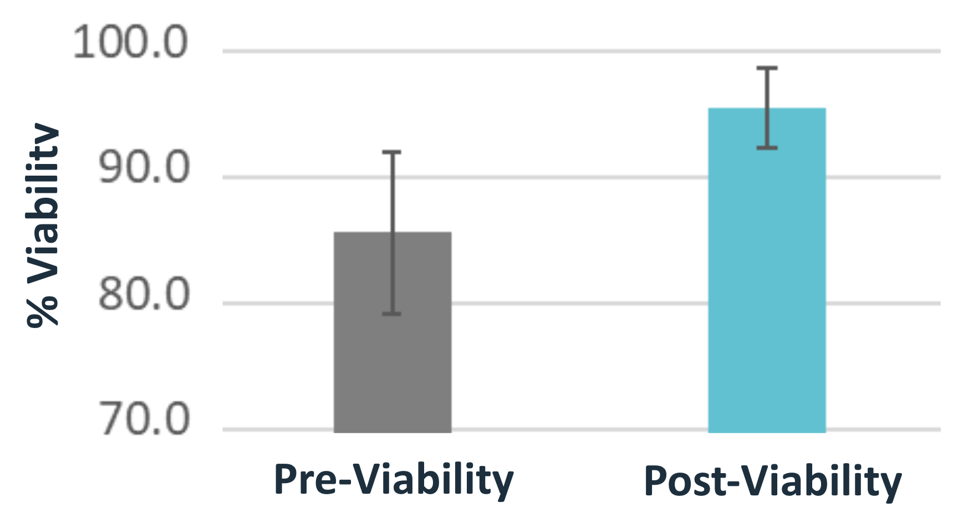
Remove Dead and Dying Organoids
Colorectal Cancer Organoids
n=3
n=3
Enrich for viable organoids from any origin
Remove dead/dying cells
Simultaneous debris removal
Suitable for both whole and dissociated organoids
Notes:
In another externally generated example, colorectal cancer organoids are show to reiterate how this process can be used for a variety of organoid types, whether they are intact or dissociated prior to the levitation process. The graph on the right is a quantification of pre and post viability of samples that have been levitated.

Slide 8
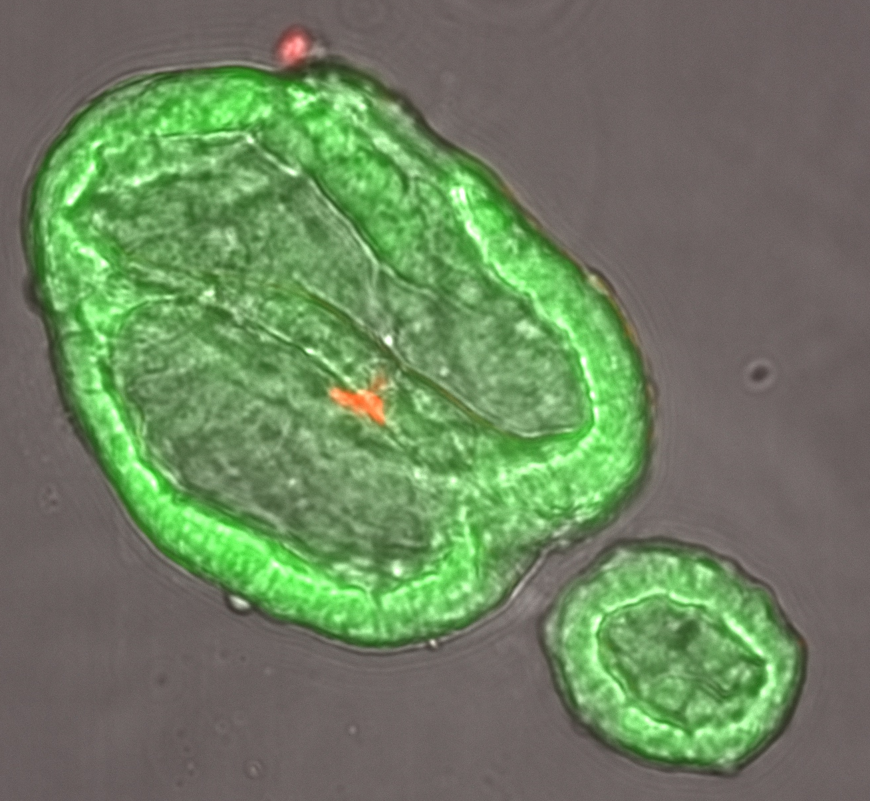
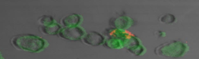
Visualizing Organoid Health in Real-Time
Calcein
PI
Human Gastric Organoids
Calcein
PI
Visualize during sample preparation
Fluorescent dyes are optional
Generate additional QC parameters with LeviMetricsTM and instrument software
Notes:
Visual qualification is also an important metric utilized by researchers working with organoids, which plays well into our technology advantage of being able to actually see the enrichment process in real time, along with the images and videos that can be used for quality assurance. This data was internally generated.

Slide 9
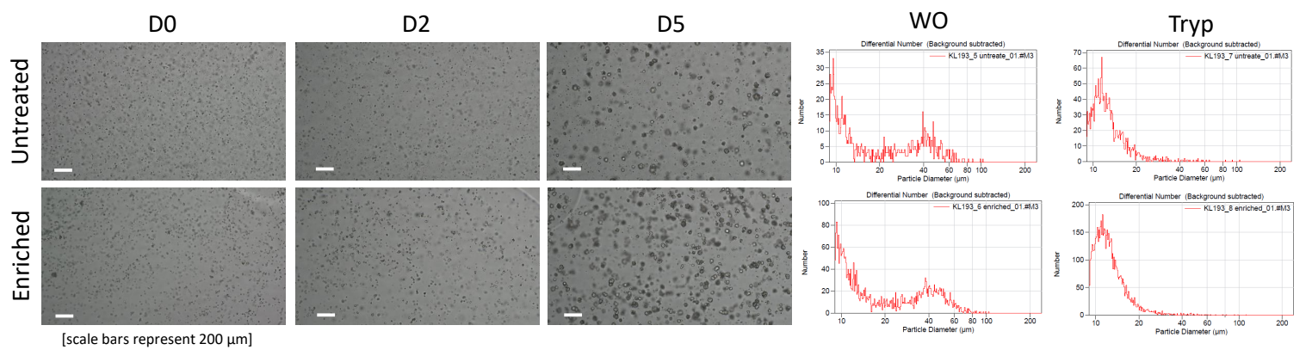
Enhanced Organoid Generation
Day 0
Day 5
No levitation
Day 5 Assessment
 | No levitation | Levitation
Particles per Dome | 1,040 | 3,388
Mean Diameter (all) | 23.7 | 24.0
Estimated output (vials) | 0.9 | 2.9
levitation
Improve downstream culture efficiency
Reduce time and required resources
Maximize production number and quality
Notes:
As mentioned the benefits of levitating organoids is not simply restricted to improving and enabling sample cleanup, but it also gives researchers a higher quality starting material that is reflected in subsequent culturing steps necessary to generate additional organoids. The images in the upper left show the difference that are observed 5 days post-processing. There are more than three times the number of particles per dome when using levitation to enrich for viable organoids, meaning that researchers can reduce the amount of time and resources required to generate sufficient numbers necessary for additional experiments, maximizing production and quality.

Slide 10
Maximize Sample Preparation with Levitation Technology
Simplified, combinatorial workflow
Fast, gentle & semi-automated process
Provides exceptional enrichment for a variety of organoid types
Removes debris & increases viability
Maximize organoid potential
Notes:
Here is a summary slide of some of the key takeaway points

